Slide 1
Making the Most of OpenAsset
Lessons Learned and Tips for Success
Anna Derocher, Marketing Manager
Notes:
I’m excited to share how we’ve been using OpenAsset at Fehr Graham what’s worked, what hasn’t and what you can take away if you’re considering it.
Fehr Graham is piloting OpenAsset for Trilon. The hope is what we learn will benefit all our sister firms if they choose to use the platform.

Slide 2
AGENDA
Why OpenAsset? (Problem)
Why Open Asset? (Solution)
How It’s Going
Where We’re Going
What We Wish We Knew
What You Can Do Now
Questions

Slide 3
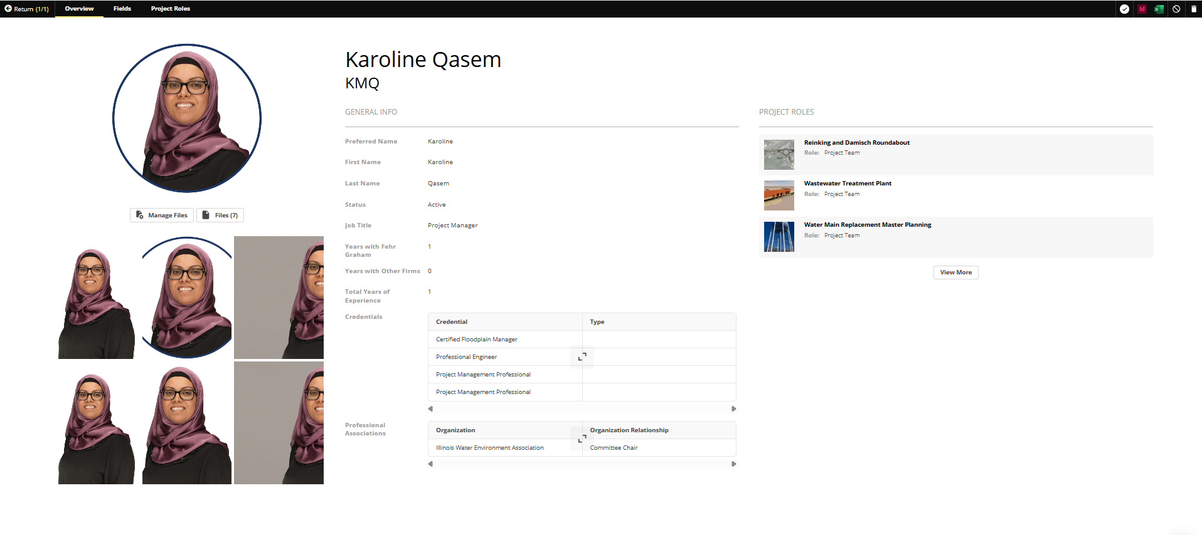
WHY OPENASSET
(PROBLEM)
Manual process for storing/finding images, adding/updating case studies and keeping resumes up to date.
Time wasted searching, duplicating efforts.
Lack of standards → branding inconsistencies.
Centralized pursuit team launch.
Notes:
We have an asset directory on our network. We’ve used everything from Excel to network folder searches to find content. While the system worked for us, it was manual. We had files scattered across folders, multiple versions of the same photo and no great way to find what we needed quickly. This slowed us down.
The decision to move to OpenAsset coincided with our plan to centralize the pursuit team and move it under Marketing. If we’re going to do that, it was time to bite the bullet and make OpenAsset happen.

Slide 4
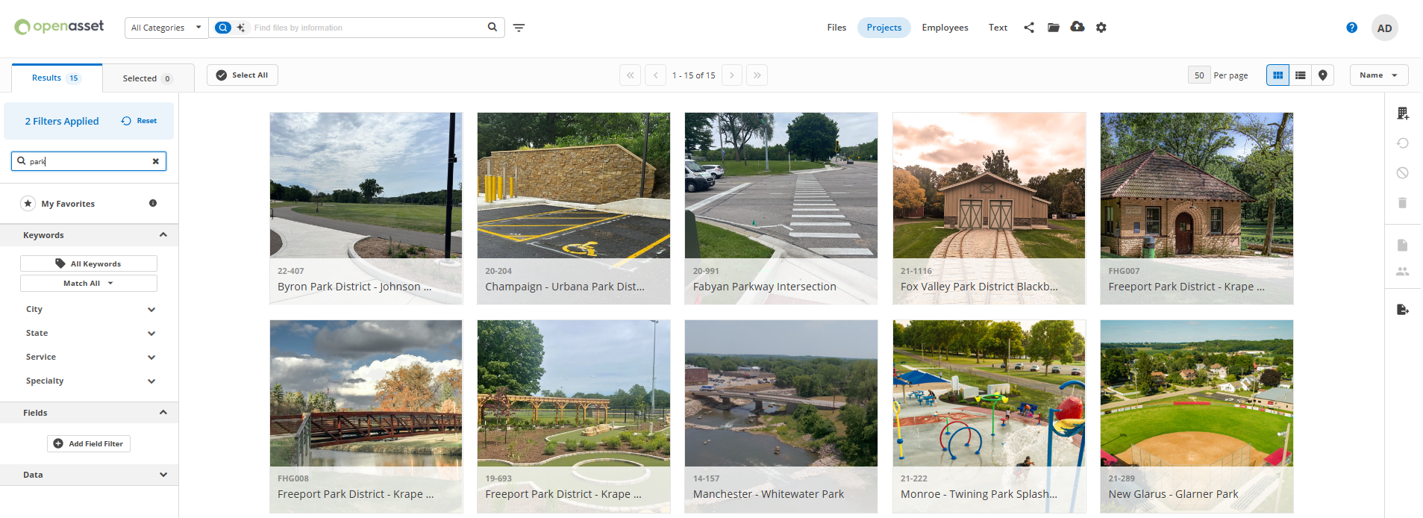
WHY OPENASSET
(SOLUTION)
  Needed a centralized, searchable library.
  Goal: Save time, improve consistency, elevate competitive proposals.
  Best fit for AEC firms.
Notes:
We wanted a single source of truth for project images, case studies and resumes – something easy, consistent and scalable. After evaluating options, OpenAsset stood out because it’s designed specifically for AEC firms.
OpenAsset and Vantagepoint communicate with each other. Each night, updates in Vantagepoint will feed into the data warehouse which will feed into OpenAsset.
We WILL use Vantagepoint CRM as the single point of truth for all employee and project data.

Slide 5


HOW IT’S GOING
Future Wins | Challenges
Faster proposal prep. One source of truth (Vantagepoint). Centralized library. Staff adoption. Organized data. | Rethinking how you build case studies and resumes and organize photos. Learning curve. Change management. Takes time.
Notes:
The wins will be great and immediate when we are fully launched.
We are in the process of moving all case study and resume content and images into OpenAsset. As we do this, we shut down the network files.
Don’t expect this to happen overnight. Managing assets takes constant effort and care. It’s not a flip-the-switch solution.
For perspective, we decided to go with OpenAsset in December. We started in February and we’re still building the database. We’re doing this WHILE we do our day-to-day work. Our team is small, so dedicating one or two people full-time to this wasn’t an option. As we’re getting closer to being able to use it to produce case studies and resumes, we are adjusting workloads so there is more focus on OpenAsset.
Touch on working in InDesign instead of Word for some wins, too.

Slide 6
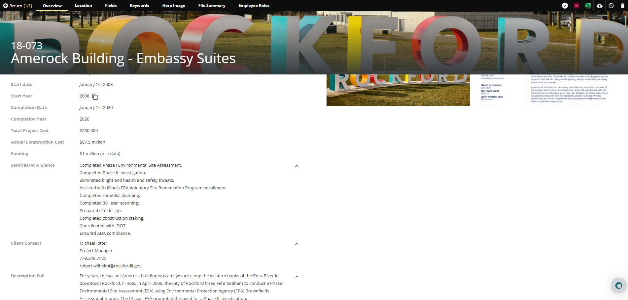
WHERE WE’RE GOING
  Expand database.
  Integrate with Deltek/CRM/InDesign.
  Standardize best practices.
  Keep up with training/best practices.
Notes:
We’re building for the future – more data, stronger integrations and oversight/maintenance that makes this tool part of our everyday workflow.
We expect these wins over time:
Proposal prep time reduced.
Relevant case studies easier to find.
Shorter versions of case studies and resumes built on the fly.
Central library of submittals.
Improved look/feel of pursuits.
AI to help us create approaches, letters, etc. based on other submittals. AI tool is expected to also review the RFQ/RFI and help us lay out the submittal based on the requirements.

Slide 7

WHAT WE WISH WE KNEW
  Database takes time to build – plan for it.
  Allow time to coordinate with Trilon.
  Adoption = ongoing advocacy. This isn’t going to be the “way we’ve always done it.”
  Structure + naming strategy is critical.
  Needs maintenance like any system.
Don’t let perfect be the enemy of good.
Crap in = crap out.
Notes:
If I could go back, I’d plan more time for understanding how OpenAsset works, developing a stronger roadmap to get there, setting clearer adoption expectations and starting with a tighter structure. OpenAsset is powerful, but it takes discipline.
With the Trilon1 conversion happening this year, it was important we coordinated with Trilon to figure out how we were going to manage assets going forward. We weren’t, for example, using CRM to store marketing versions of resume and project information. We had to determine what data we would store in OpenAsset and how Vantagepoint would communicate with OpenAsset. We decided that Trilon1 would be our data source, so we are creating workflows to ensure information is stored in the right spots in Vantagepoint. From there, the information will go to the data warehouse/data hub and then to OpenAsset. That is not set up yet so we got creative so we could build OpenAsset during the Trilon1 migration process.
We expect these wins over time:
Proposal prep time reduced.
Relevant case studies easier to find.
Shorter versions of case studies and resumes built on the fly.
Central library of submittals.
Improved look/feel of pursuits.
Shred.ai (OpenAsset add-on) to help us create approaches, letters, etc. based on other submittals. Shred.ai is expected to also review the RFQ/RFI and help us lay out the submittal based on the requirements.

Slide 8
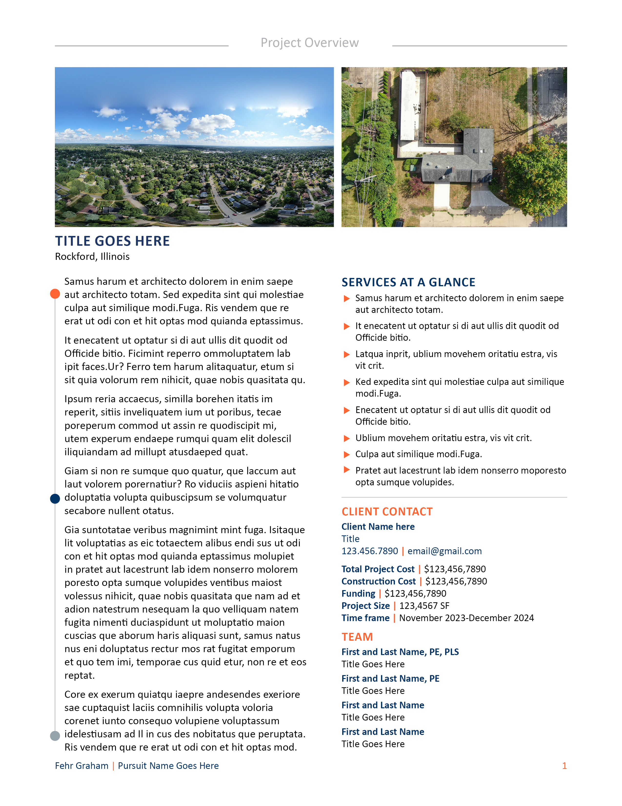
WHAT YOU CAN DO NOW
  Assess your photo library. Is it consistent? (C:Marketing\Project Name or C:Marketing\Client name\Project Name or C:Marketing\Sector\Project Name)
  Define goals before software.
  Think about your templates (if you want to change your look/feel/templates, now’s a good time).
  Plan for training and upkeep.
  Talk to your friends (Emily Massingill and me) at Fehr Graham.
Notes:
If you’re considering OpenAsset, start small. Clean up your library, set goals, and get your structure right. For photos, the recommendation is to not to worry about filenames and including project data there, but instead to ensure that your project photography is in unique folders, all at the same level in the folder structure. This groundwork makes everything easier later.

Slide 9
QUESTIONS?
Anna Derocher, CPSM
Emily Massingill
MARKETING MANAGER
aderocher@fehrgraham.com
815.394.4700
SENIOR MARKETING COORDINATOR
emassingill@fehrgraham.com
815.394.4700
Notes:
OpenAsset has been a big step forward for us, but it’s a journey. I hope sharing our lessons helps you decide how to approach it. I’d love to hear your questions or experiences.

