Slide 1
State of the Union
Michael Converse

Slide 2
Let’s Start with a Quiz
Look closely at
the following images

Slide 3
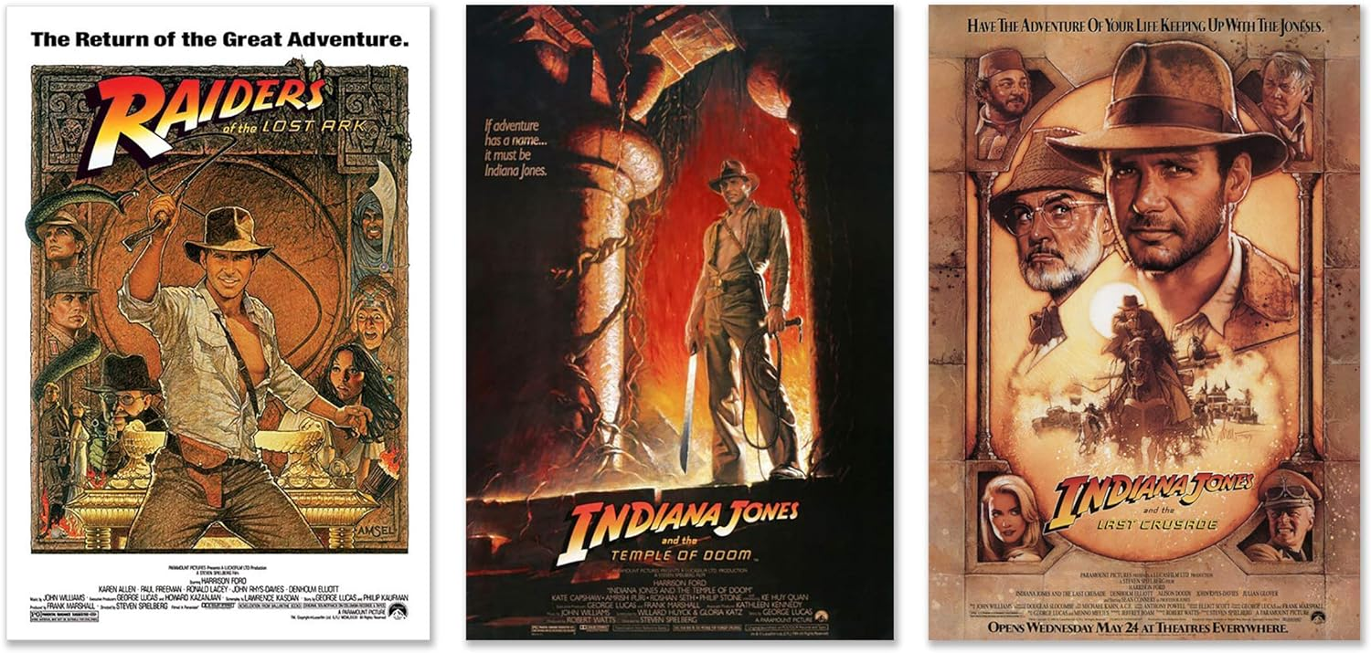
Notes:
Let’s start easy. Tell me what you see. Whare are we looking at? Best answer gets a $2 bill
First 3 installments of the Indiana Jones series

Slide 4
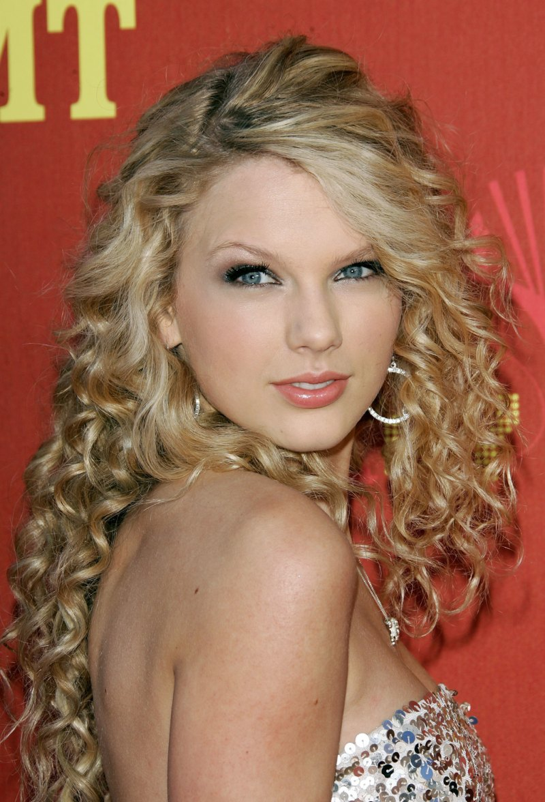
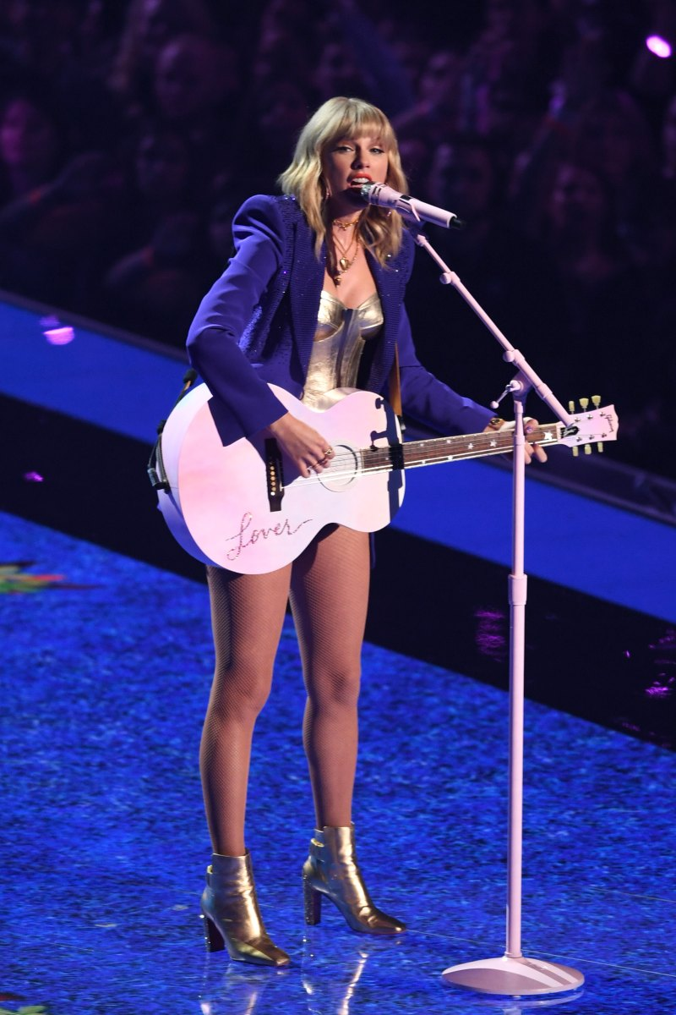

Notes:
What are we looking at?
The evolution of lawn mowers – from manual, to motorized to cordless whipper snipper

Slide 5

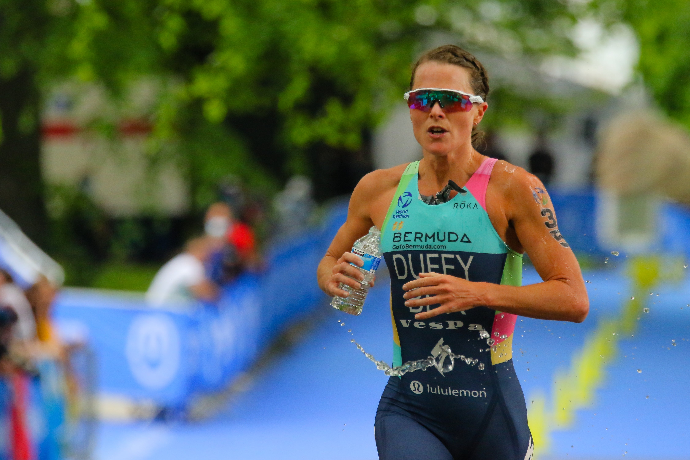

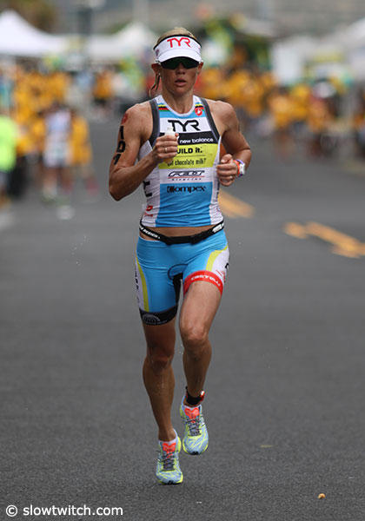
Notes:
- What are we looking at?
- 3 legs that make up a triatholon or Iron Man

Slide 6
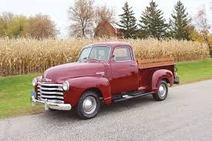
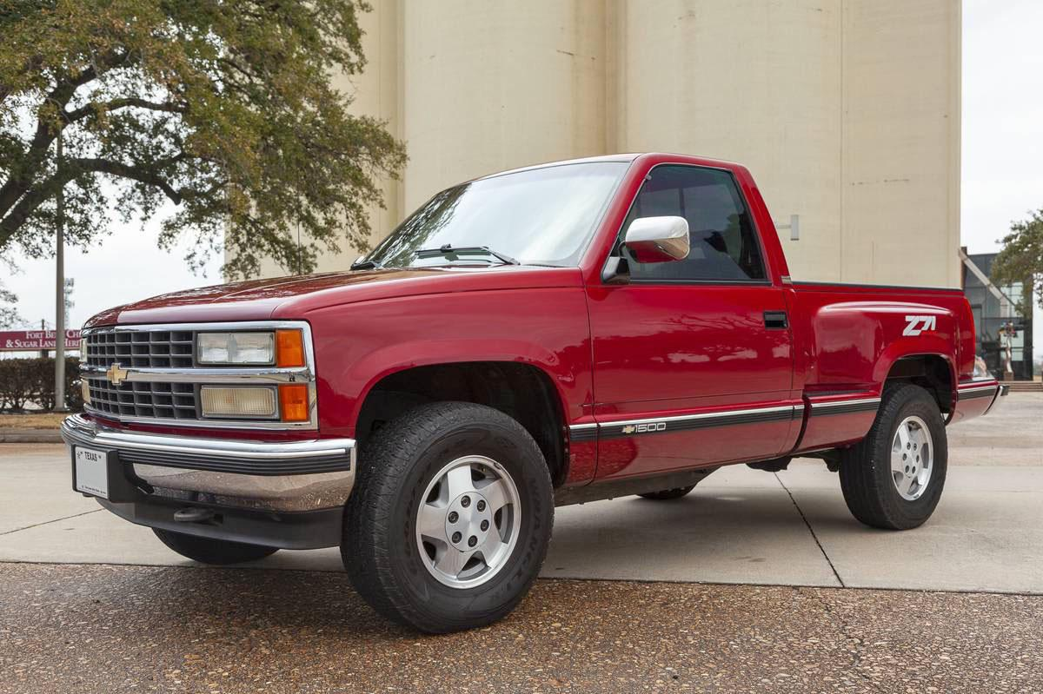
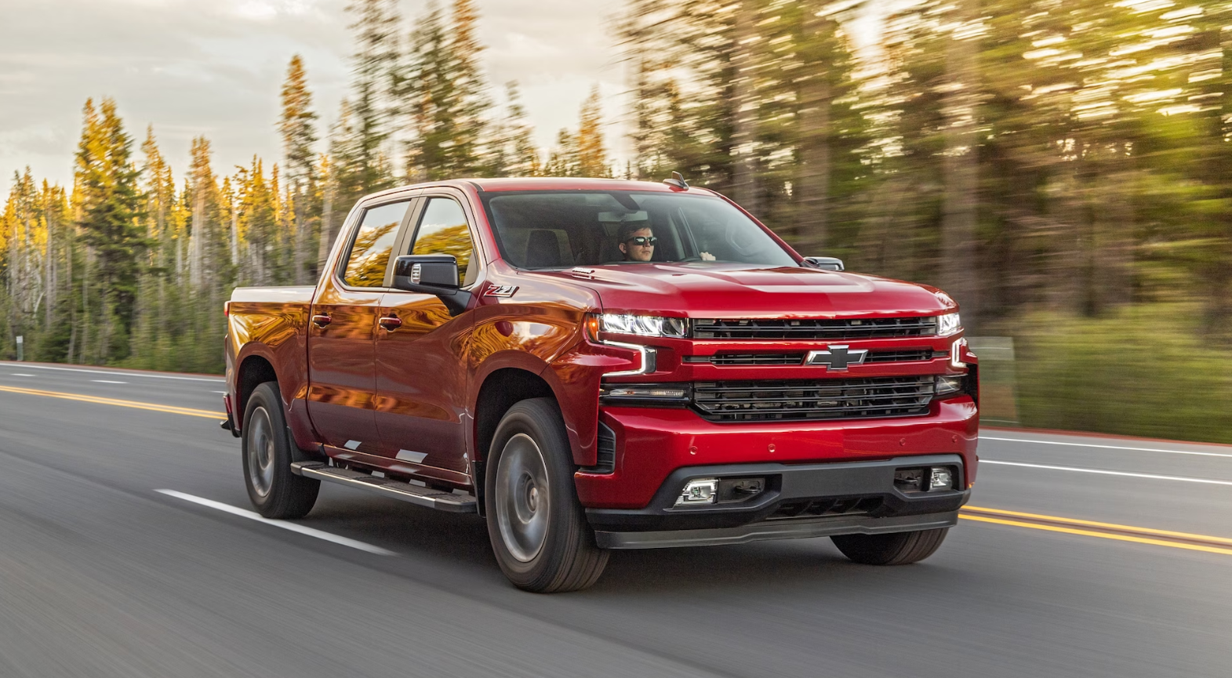
Notes:
What are we looking at?
GMC Chevy Trucks from the 1950s, 1990s and Today. Specifically, the Silverado

Slide 7
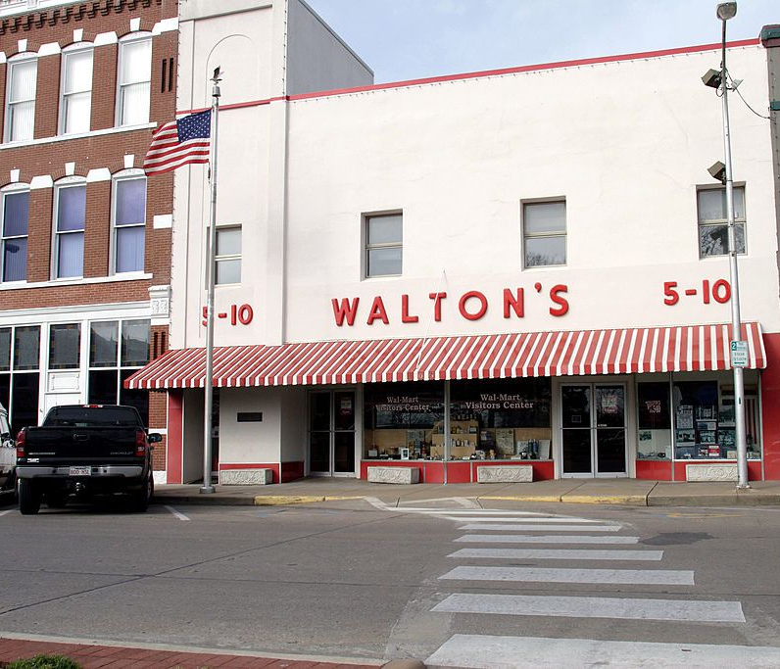
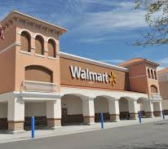
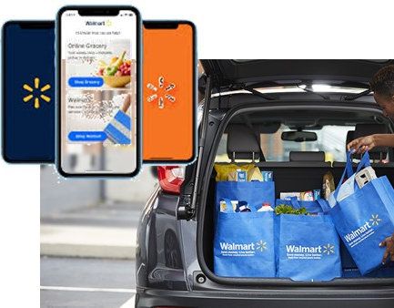
Notes:
What are we looking at?
The original Waltons, a Walmart Supercenter, and mobile/drive up features

Slide 8
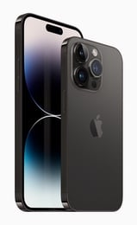

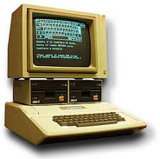
Notes:
What are we looking at?
The first Macintosh, iPOD ad latest iphone

Slide 9
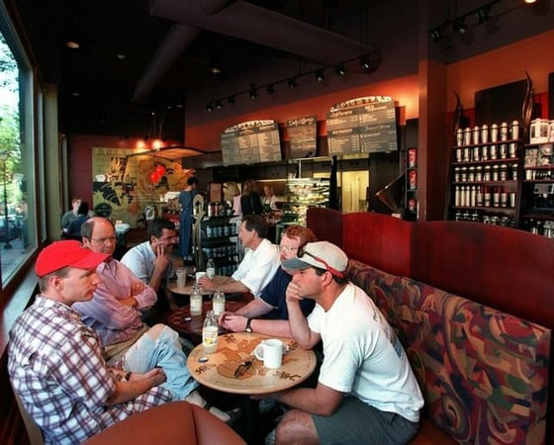

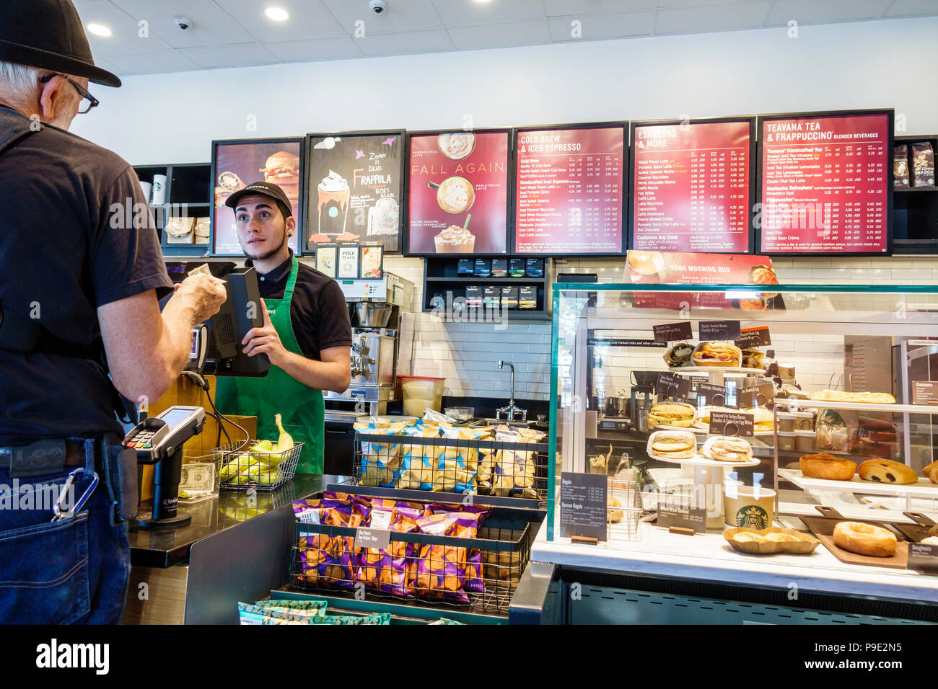
Notes:
What are we looking at?
The evolution of Starbucks….3rd place, reinventing coffee shop beverages, owning breakfast

Slide 10
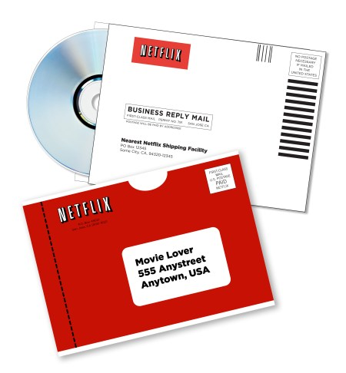
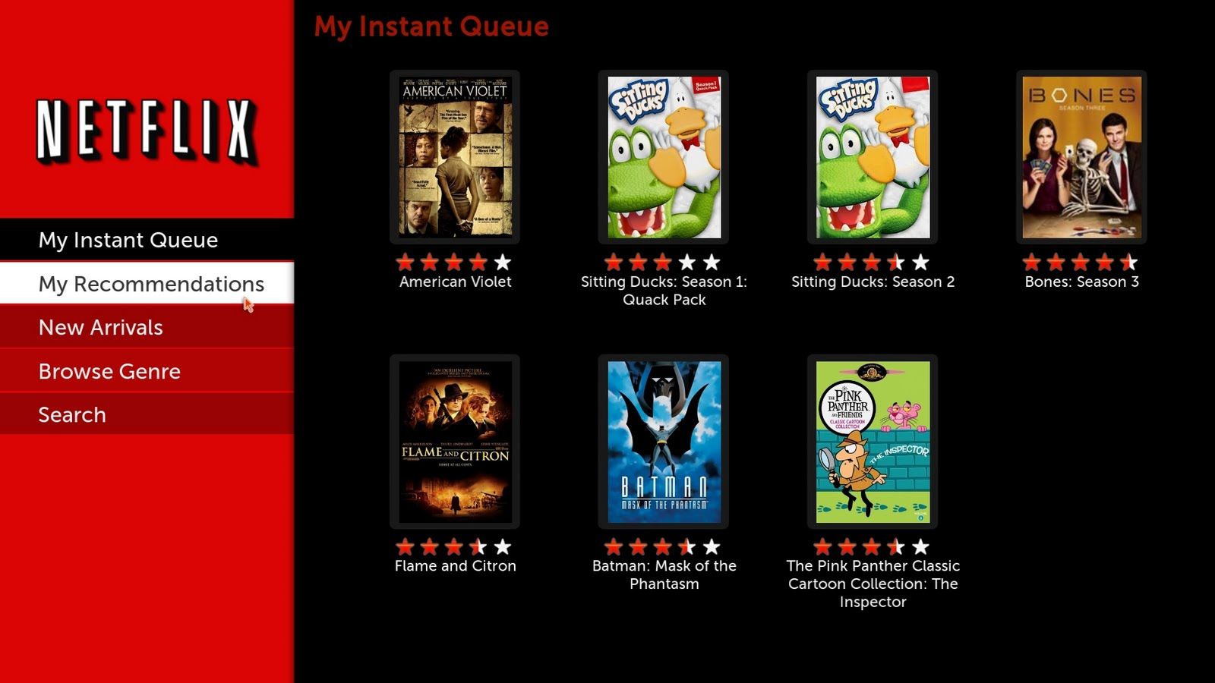
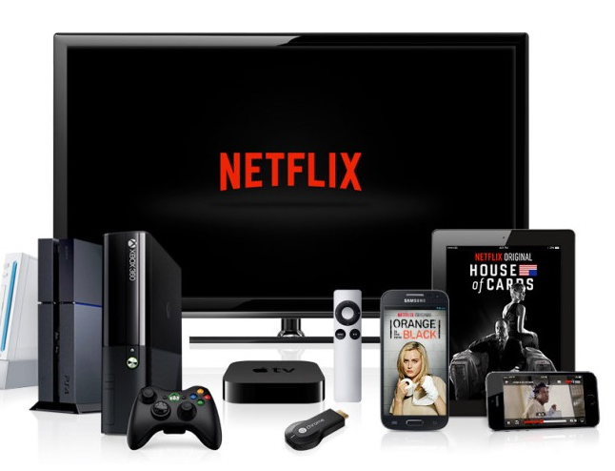
Notes:
What are we looking at?
Netflix. From mailer DVDs to a browser to device proliferation (and content production)

Slide 11
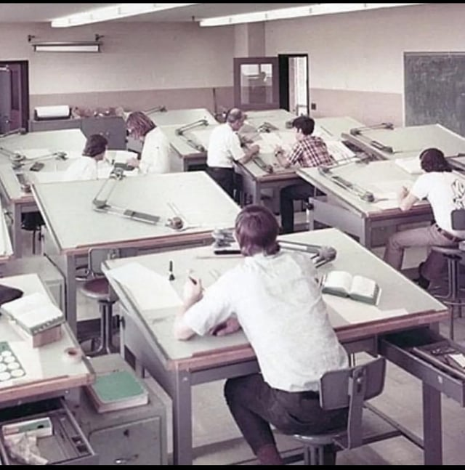
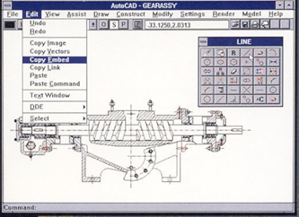
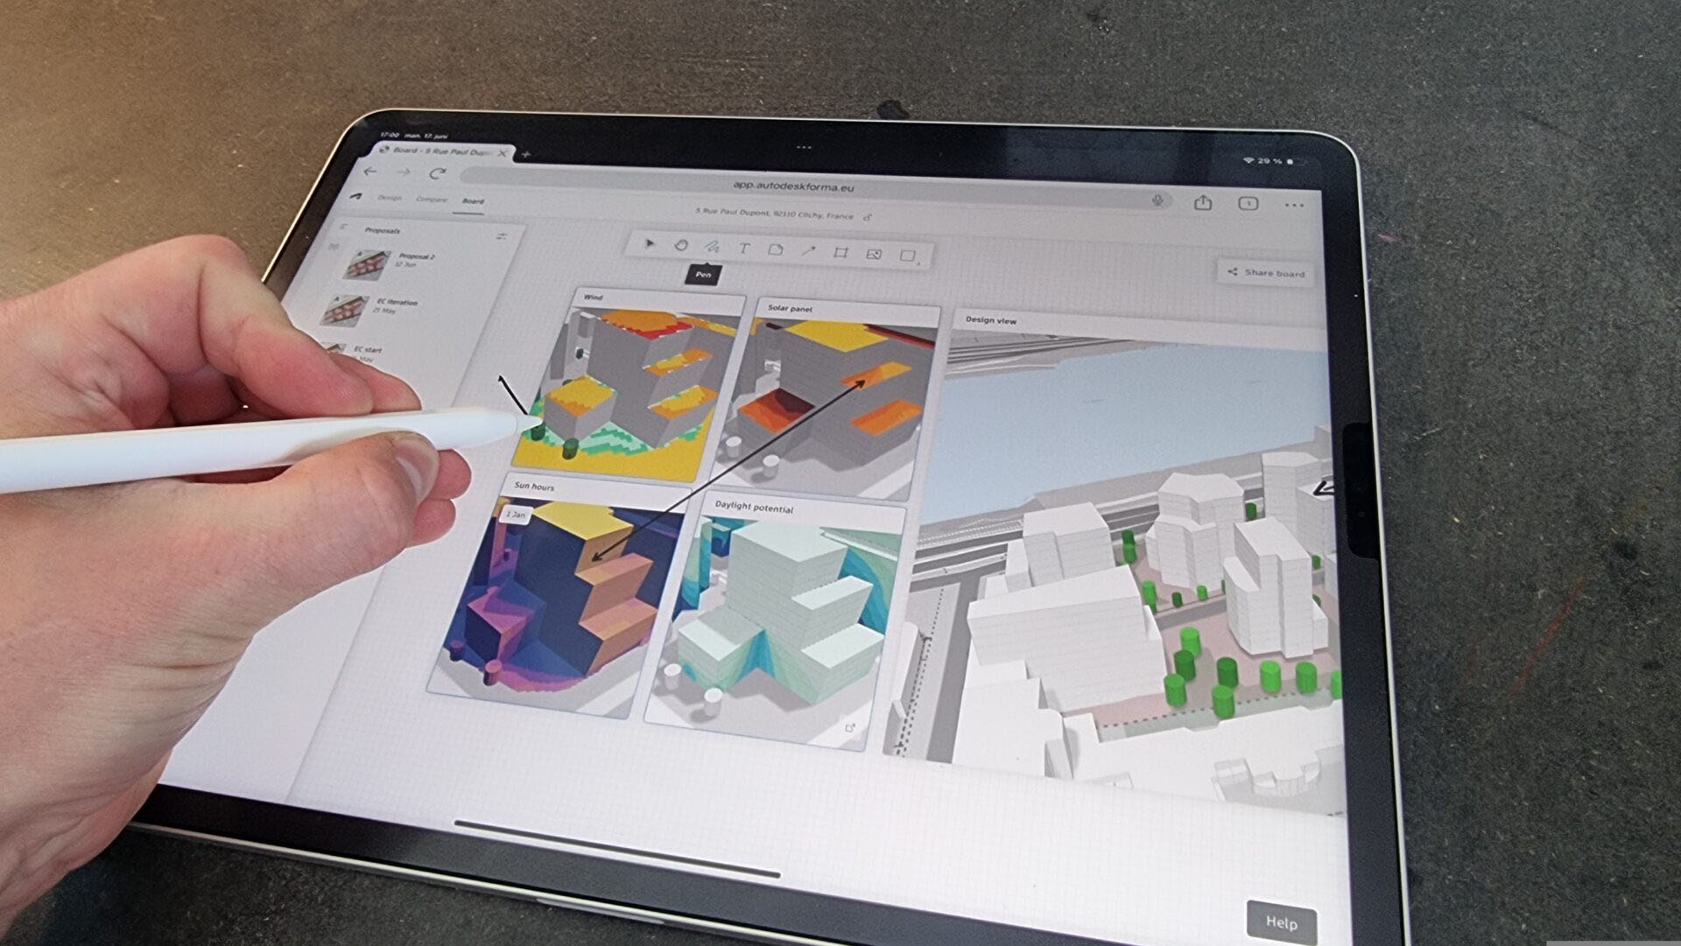
Notes:
What are we looking at?
Evolution of how Engineers work…from drafting tables, to cad, to mobile 3d AI….

Slide 12
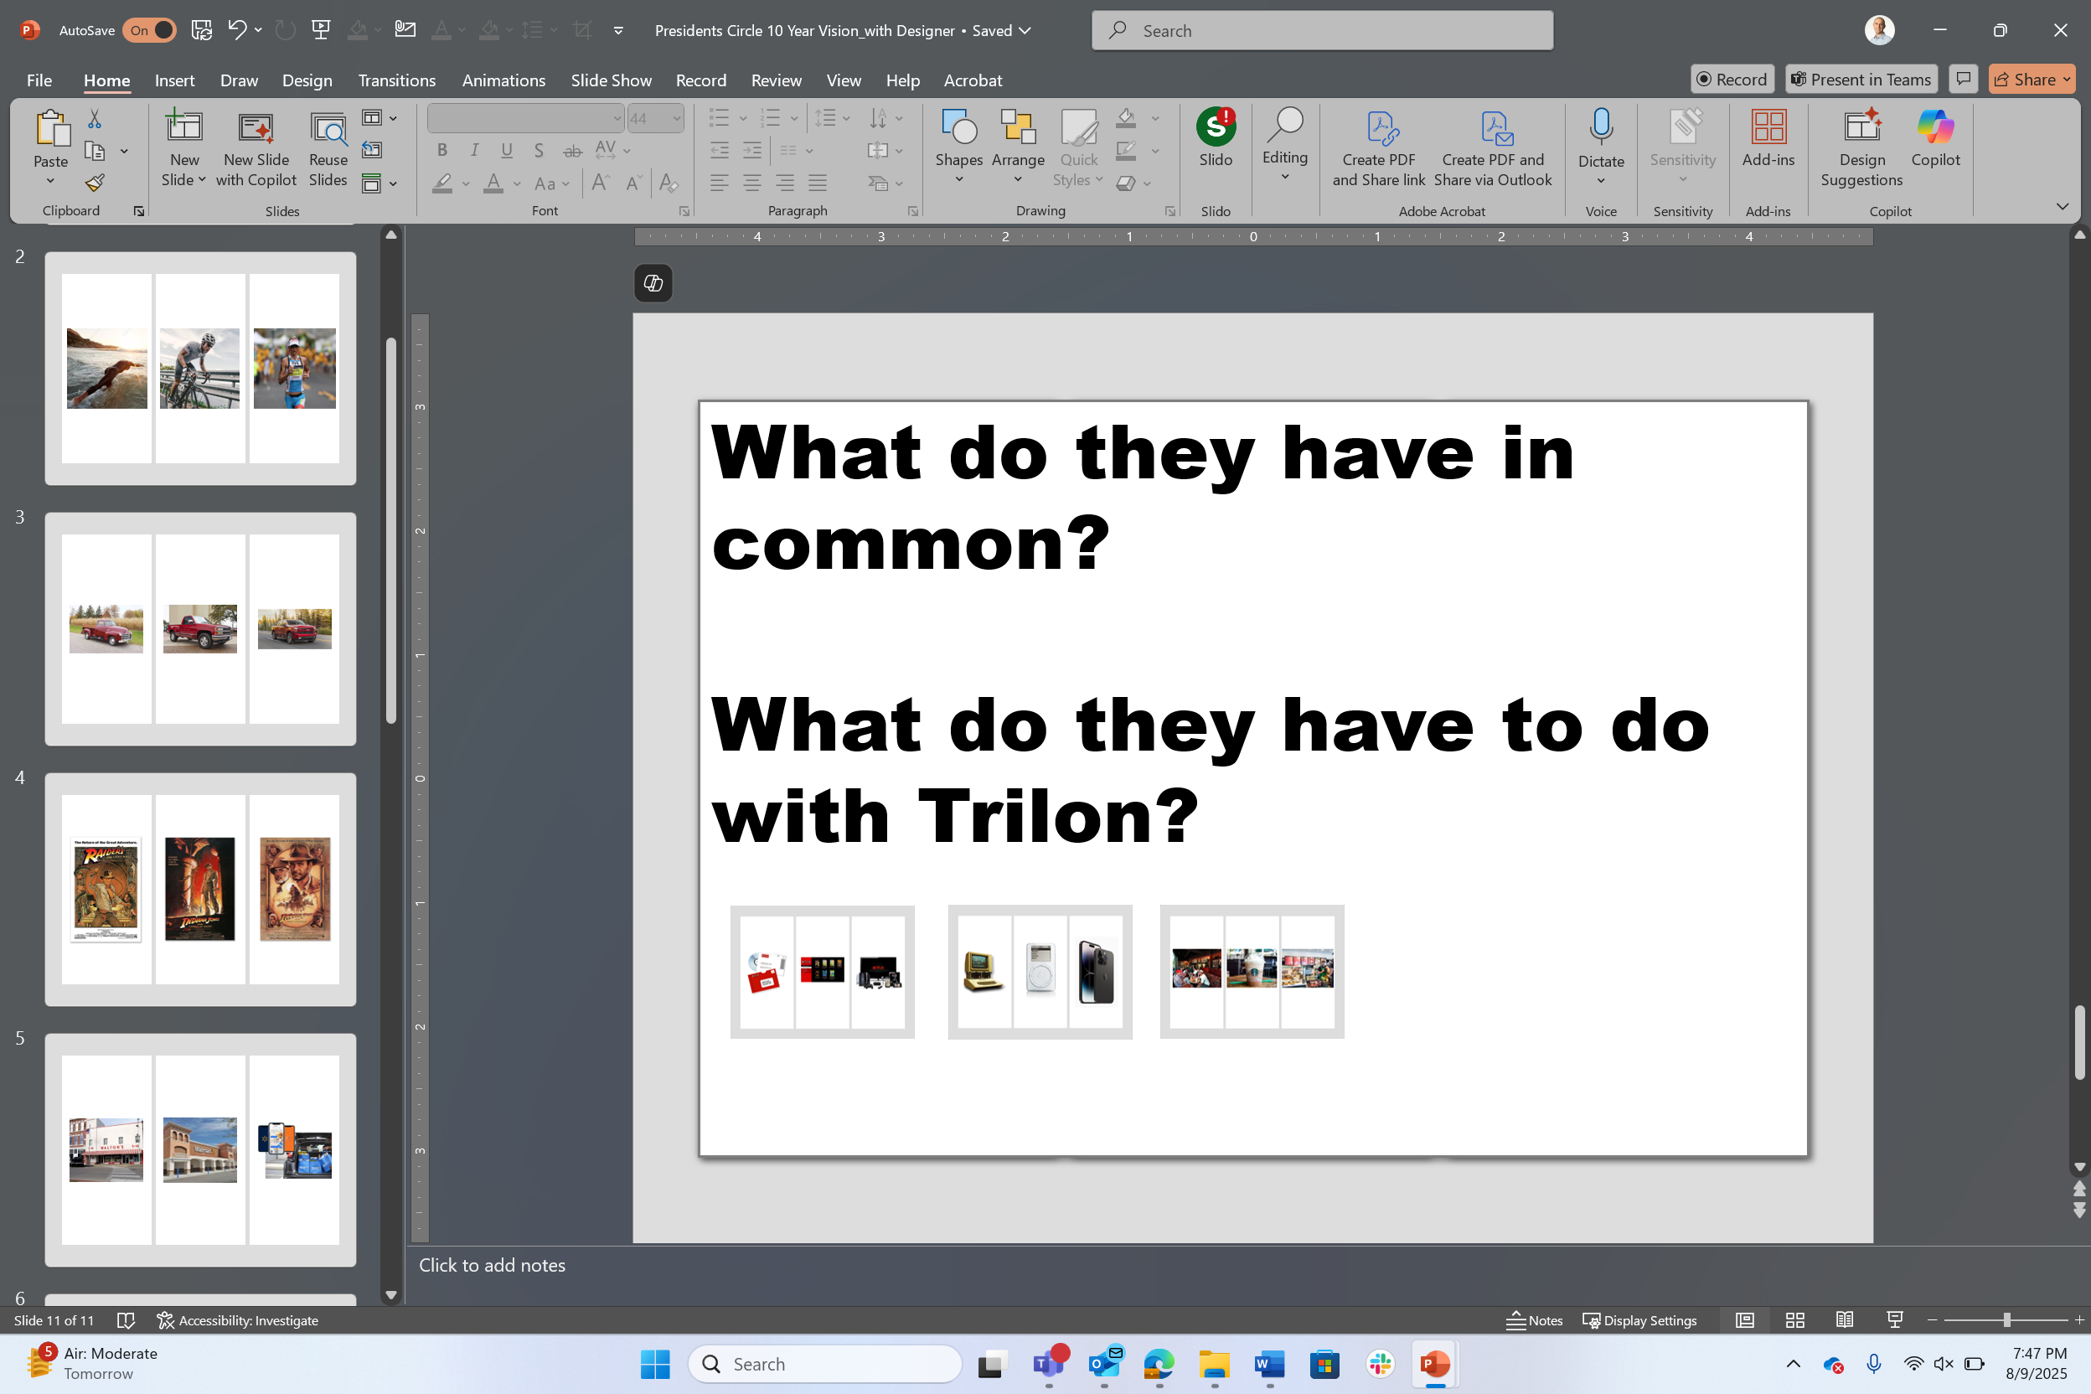
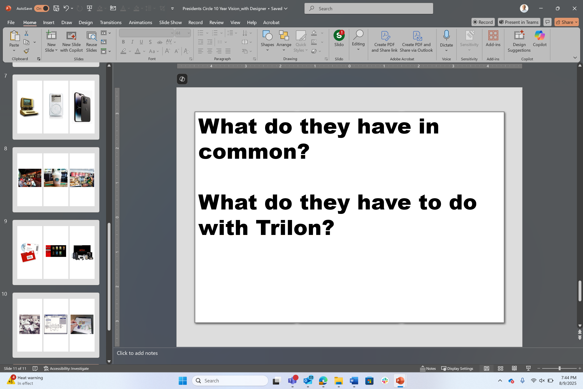
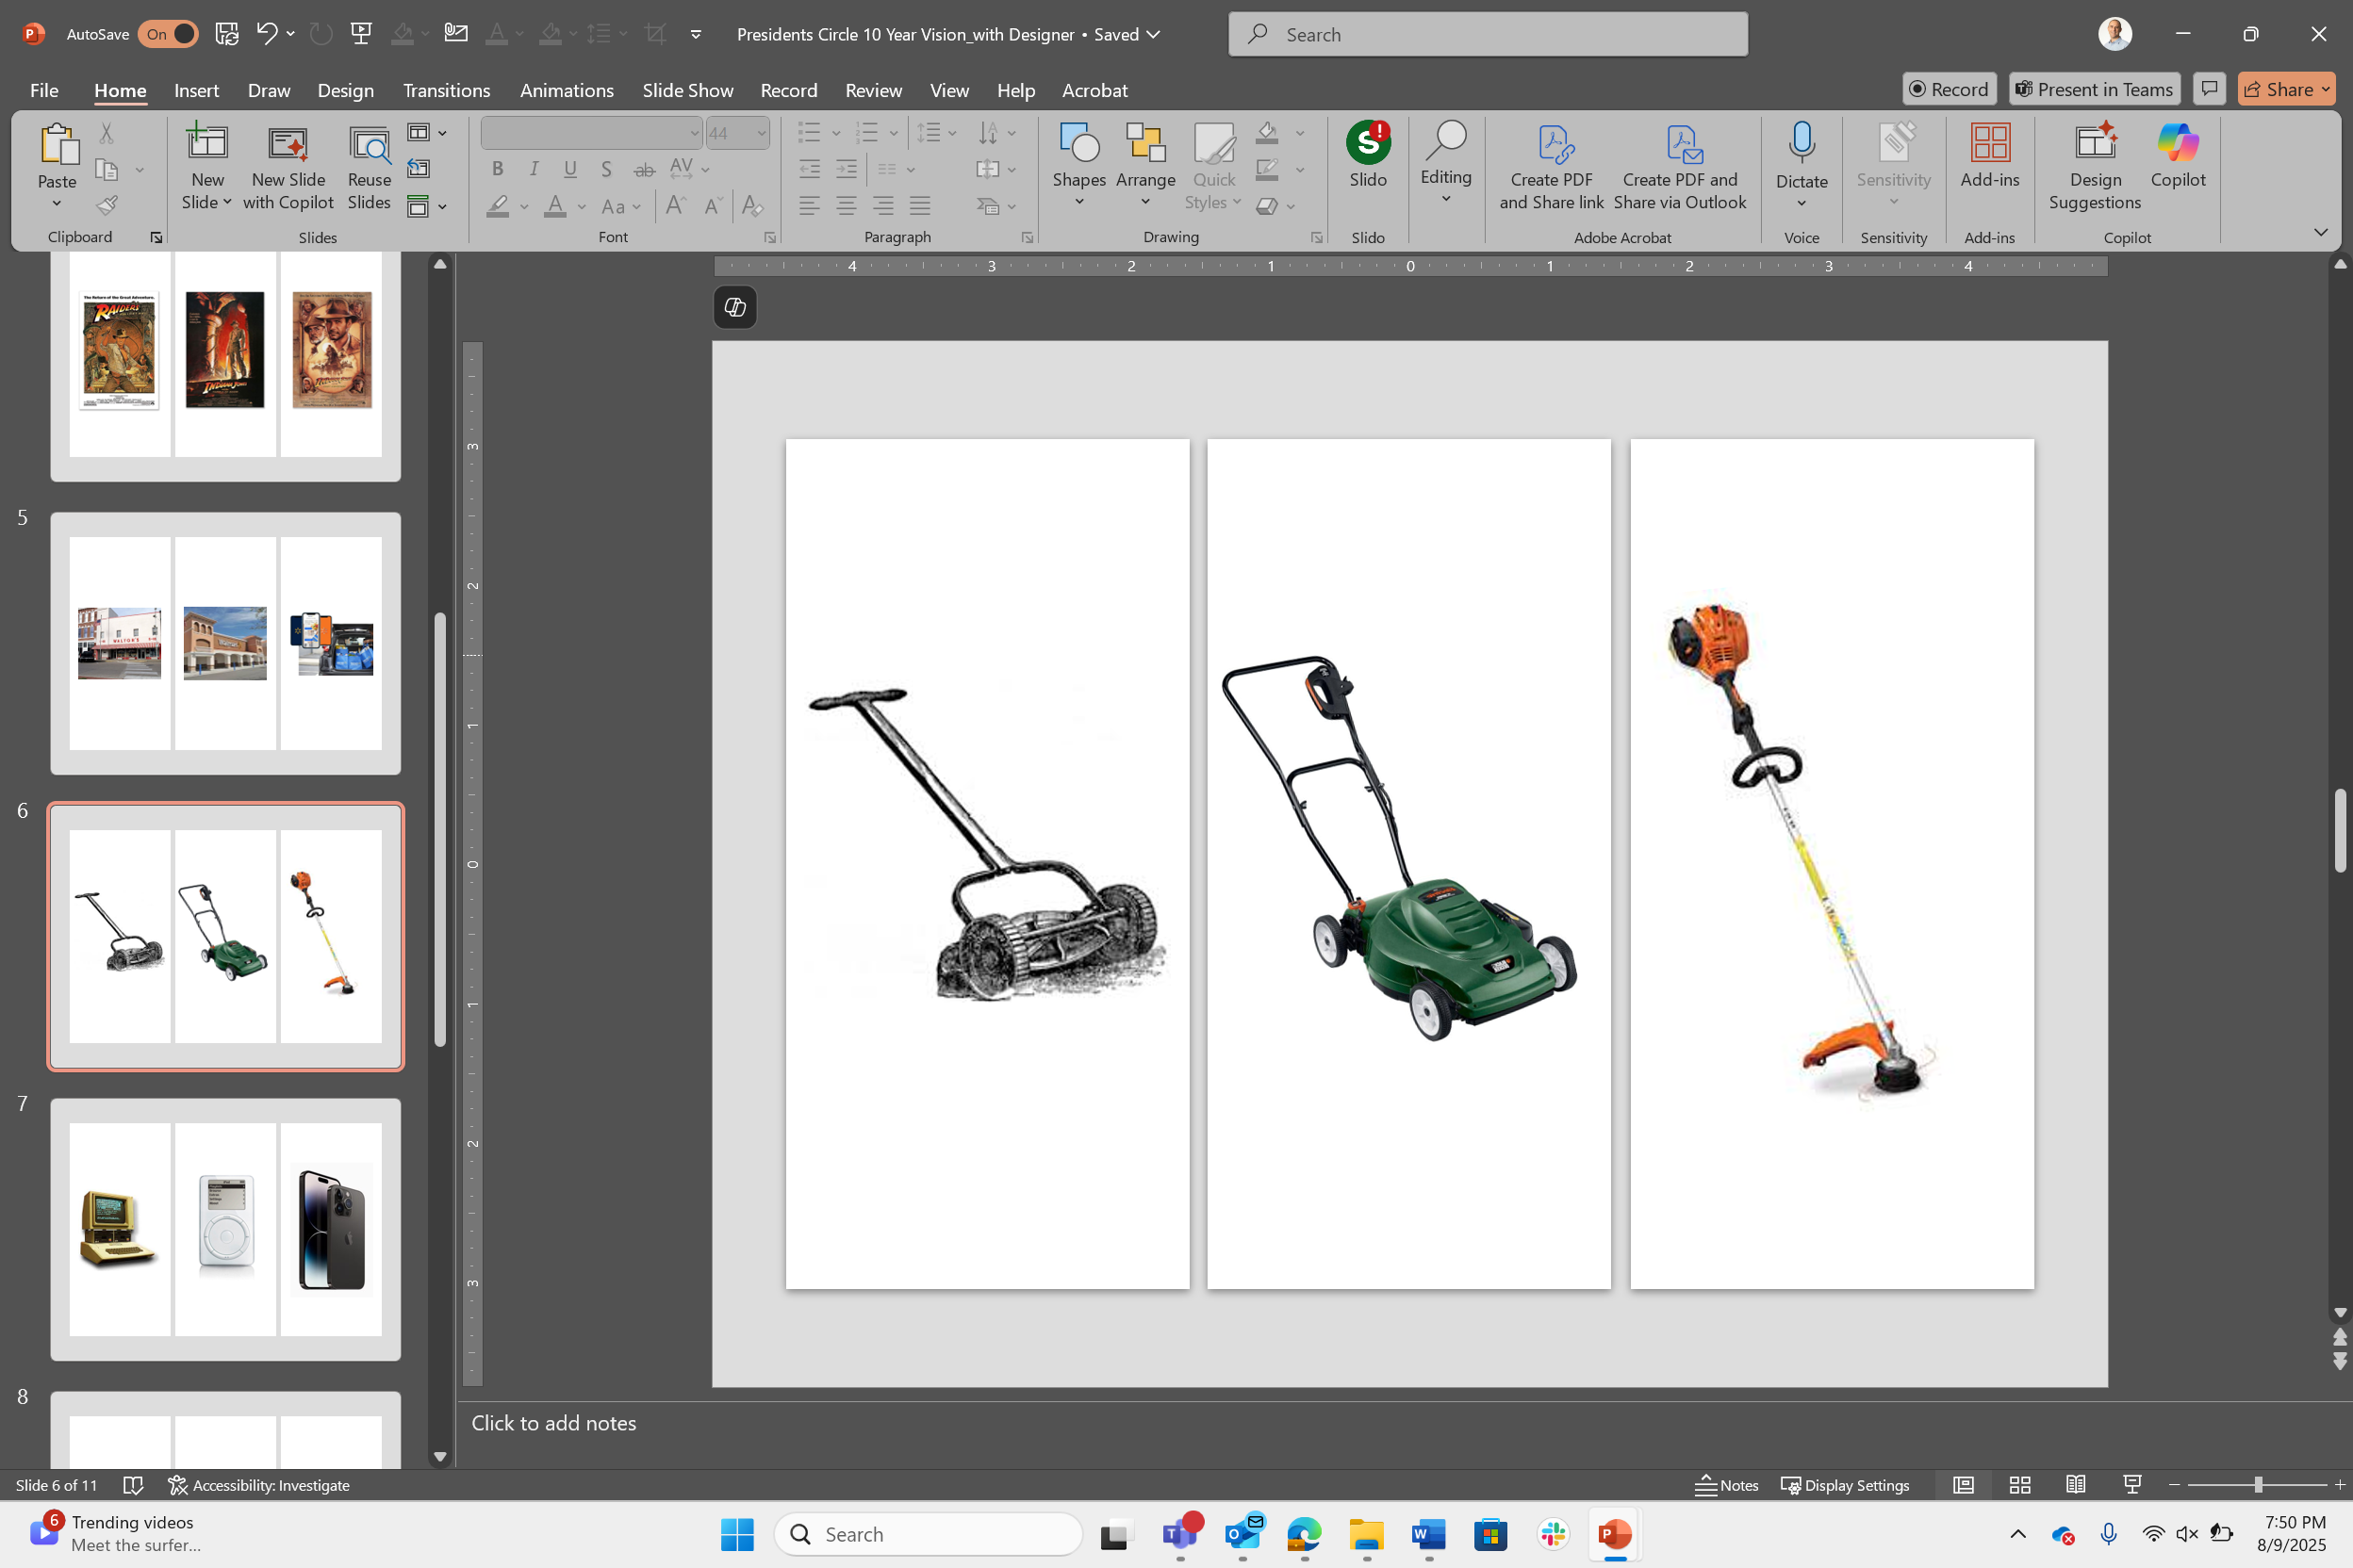
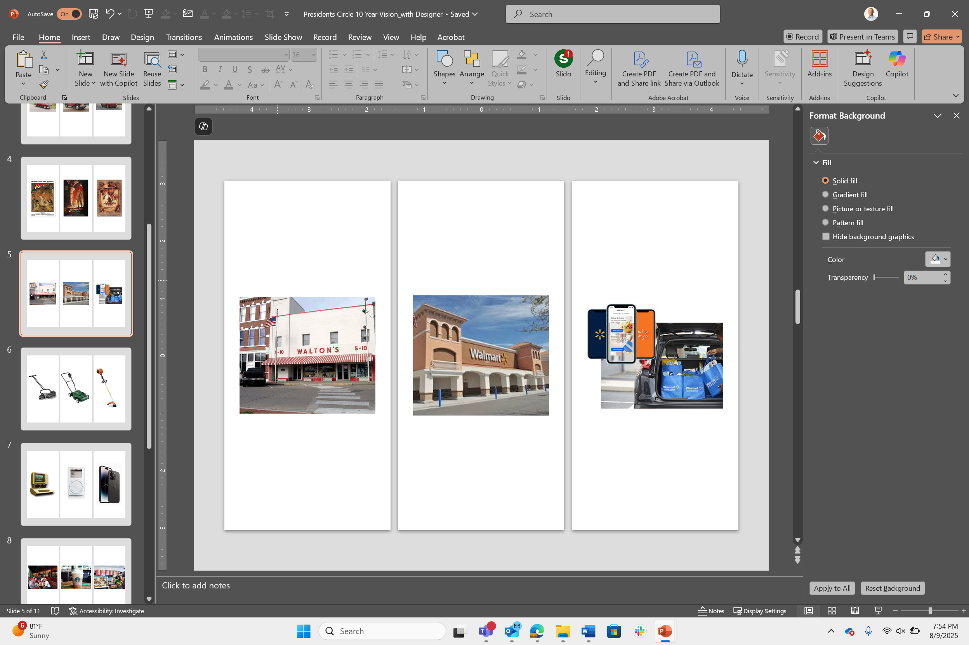
What do they have in common?
What do they have to do
with Trilon?

Slide 13
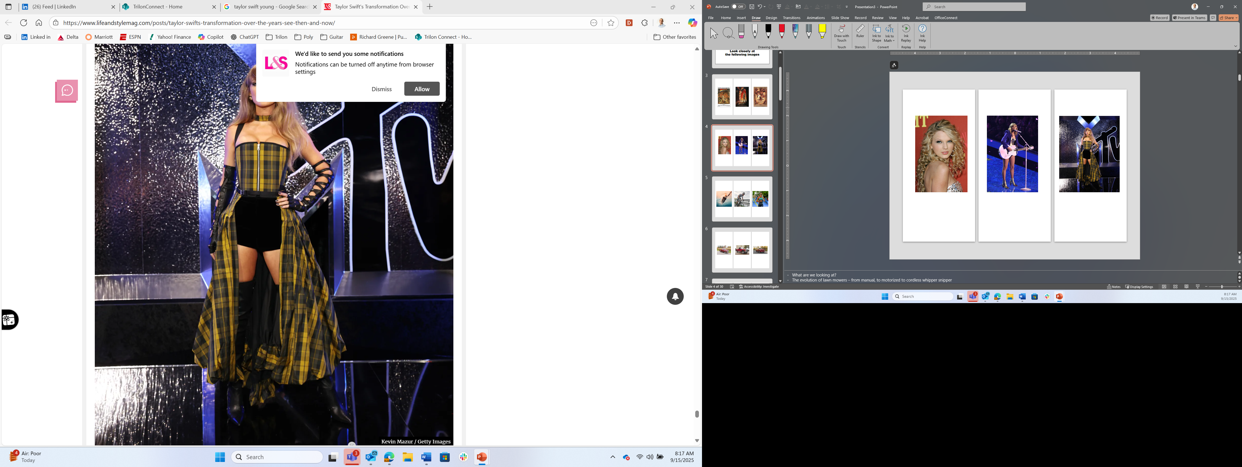
Ok, so…
Which image
is missing?

Slide 14
What Stage is Trilon in?
What’s missing from
these pictures?
Notes:
- The Triathalon/Iron Man image was missing
So after seeing all these pictures and thinking about stories of great enduring businesses, where do you think Trilon is? Let’s get a show of hands? Run? Bike? Swim?
For my last $2 bill, what’s missing from this set of images? That’s right – a finish line. A finish line is about individuals/about us. It’s not about our employees. It’s not about an enduring company. Do you think Apple, Microsoft or GM are thinking about a finish line?

Slide 15
No Finish Line
(an enduring company, remember?)
Notes:
- The Triathalon/Iron Man image was missing
So after seeing all these pictures and thinking about stories of great enduring businesses, where do you think Trilon is? Let’s get a show of hands? Run? Bike? Swim?
For my last $2 bill, what’s missing from this set of images? That’s right – a finish line. A finish line is about individuals/about us. It’s not about our employees. It’s not about an enduring company. Do you think Apple, Microsoft or GM are thinking about a finish line?

Slide 16
Curious where Trilon
will be in 10 years?
Notes:
Ok. Enough already, Converse. If you’re at all curious where Trilon will be in 10 years….please give it up for our founder, CEO and Captain, My Captatin, Mick Renshaw

Slide 17
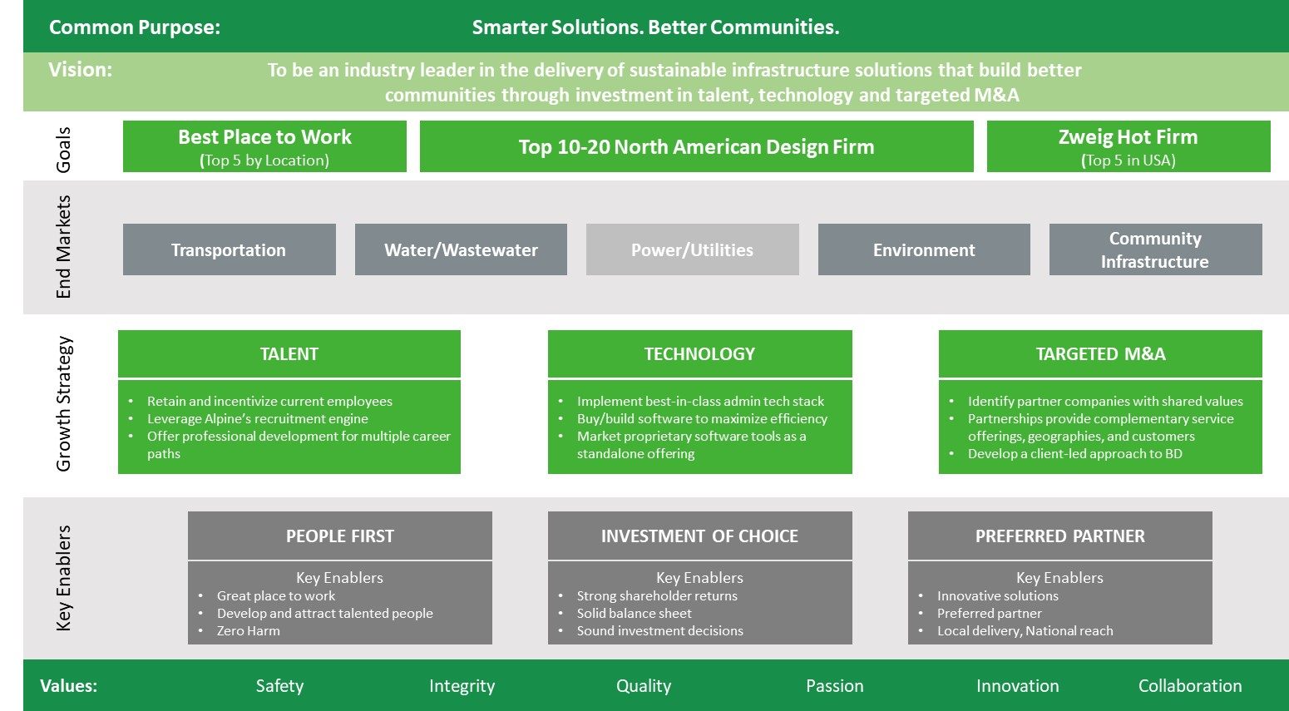
2022 – 2025 Vision
Building an enduring North American design firm through our unique (functional) family-of-firms model

Slide 18

First Leg Accomplished - Record Pace!
Together, we achieved the first milestones we set ourselves – an ENR TOP 20 FAMILY OF FIRMS
#20
13
PLATFORM PARTNERSHIPS
25
ADD-ONS
+5 UNDER LOI
2025
>$150
MILLION EBITDA

Slide 19
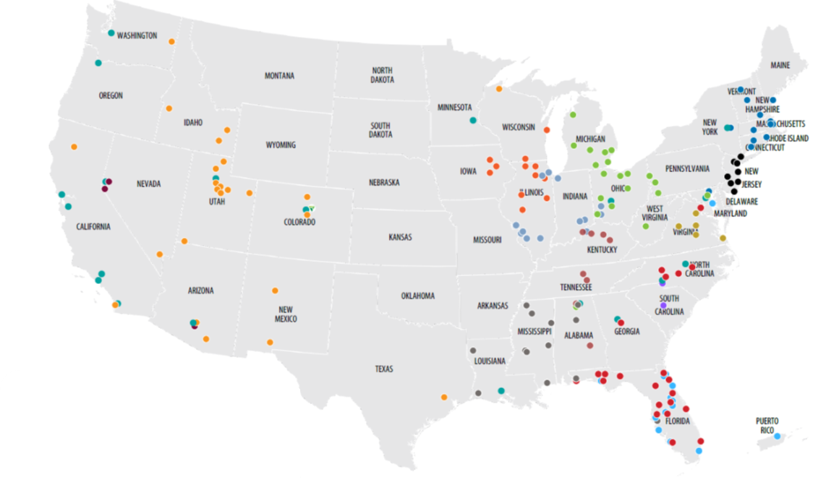
Fastest Growing AEC Firm… Ever!
We proved a Family of Firms model not only works, but works better
A Revolutionary Model…
…Proven!

Slide 20
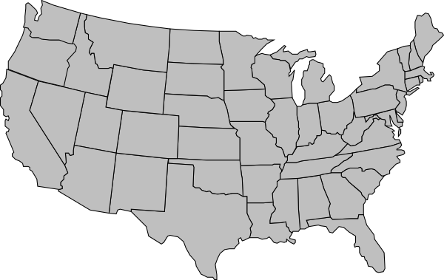














Current Status | The Numbers
$610M+
$610M+
$610M+
10%
Organic Growth
17%
EBITDA Margins
5,600+
Employees
$1.40B
Backlog
$1.27B
Gross Revenue
$1.05M
Net Revenue
Geographic Presence and Revenue Breakdown
End Market Mix
Service Mix
#21
Note: Average age of all partner firms is 51 years

Slide 21
Current Status | Grading our Strategy
A+
Growth: #21 Firm in 3 Years
A-
Functional Family of Firms
B+
Talent: Just getting started
C
Technology: Still integrating
A-
Targeted M&A: Best, but room

Slide 22
Leadership Culture
Functional Family
(collaborate, celebrate, call-out)
People First
(hiring, retention, development succession)
Top Decile
(best in business, safety, quality, performance)
We are all Trilon
(US not Them)
Hungry yet Humble
(swagger but no ego)

Slide 23
President focus in 2025
Culture of Hiring
(strong focus on hiring and retention of productive talent into pipeline and backlog)
Boost Business Acumen
(supporting our PMs and above to understand business drivers)
Trilon Swagger
(enhanced strategic business development on targeted major pursuits and key clients)
Top Decile Performance
(continued refinement of gross margin and operating cost)
Accelerate M&A Playbook
(bring key ‘plays’ forward with qtrly targets and accountability)

Slide 24
2025
2030
2035

Slide 25


Vision 2035 | Revolutionizing Infrastructure Consulting
Smarter Solutions. Better Communities.
Common Purpose:
Vision: To be an industry leader in the delivery of sustainable infrastructure solutions that build better communities through investment in talent, technology and targeted M&A
Top 5
Goals
Best Place to Work
(Top 5 by Location)
Top 5-10 North American Firm
($3.3b GR, $3b NSR and $660m EBITDA)
Zweig Hot Firm
(Top 5 in USA)
Transportation
Water
Facilities (Ed/Health/Commercial)
+ Energy +Environ.
End Markets
Energy/Environment
+ Accelerator
Supercharged
TALENT ACCELERATOR
TECHNOLOGY SUPERCHARGED
TARGETED M&A
Purposeful Growth
Grow careers faster than our peers
Retain and attract top talent
Best in industry recruitment engine
Pathway to employee ownership
Step-change in productivity and margins
Enhanced client and project delivery tools
Best-in-class integrated tech stack and responsible use of AI (forward looking)
Preferred home for top quality firms
Excite entrepreneurial spirit and retain talent
Accelerate growth and performance
Leverage collaboration for clients and staff
Lean in Locally
LOCAL PARTNERS
BEST IN THE BUSINESS
REVOLUTIONIZING OUR INDUSTY
Differentiators
Key Enablers
Local trusted partners of quality clients
Swagger to leverage national capabilities
Empowered and accountable local leaders
Key Enablers
Leading on Purpose, People, Profit (3Ps)
Strong business acumen
Unique, agile and scalable business model
Key Enablers
Family of companies / Aspen integration
Unmatched M&A velocity
Supercharged by technology
Values:
Safety
Integrity
Quality
Passion
Innovation
Collaboration

Slide 26
Vision 2030 | Revolutionizing Infrastructure Consulting
Smarter Solutions. Better Communities.
Common Purpose:
Vision: To be an industry leader in the delivery of sustainable infrastructure solutions that build better communities through investment in talent, technology and targeted M&A
Top 10
Goals
Best Place to Work
(Top 5 by Location)
Top 5-10 North American Firm
($3.3b GR, $3b NSR and $660m EBITDA)
Zweig Hot Firm
(Top 5 in USA)
Transportation
Water
Facilities (Ed/Health/Commercial)
+ Energy +Environ.
End Markets
Energy/Environment
+ Accelerator
Supercharged
TALENT ACCELERATOR
TECHNOLOGY SUPERCHARGED
TARGETED M&A
Purposeful Growth
Grow careers faster than our peers
Retain and attract top talent
Best in industry recruitment engine
Pathway to employee ownership
Step-change in productivity and margins
Enhanced client and project delivery tools
Best-in-class integrated tech stack and responsible use of AI (forward looking)
Preferred home for top quality firms
Excite entrepreneurial spirit and retain talent
Accelerate growth and performance
Leverage collaboration for clients and staff
Lean in Locally
LOCAL PARTNERS
BEST IN THE BUSINESS
REVOLUTIONIZING OUR INDUSTY
Differentiators
Key Enablers
Local trusted partners of quality clients
Swagger to leverage national capabilities
Empowered and accountable local leaders
Key Enablers
Leading on Purpose, People, Profit (3Ps)
Strong business acumen
Unique, agile and scalable business model
Key Enablers
Family of companies / Aspen integration
Unmatched M&A velocity
Supercharged by technology
Values:
Safety
Integrity
Quality
Passion
Innovation
Collaboration

Slide 27




Vision 2030 | Connecting the Vision to our Teams, Clients, and Add-Ons
Purposeful Growth
Growth = M&A & Organic
Growth = Career Opportunity
Growth = Impact & Legacy
Growth = Change
Purposeful Growth
Talent Accelerator
TALENT ACCELERATOR
Career Advancement
Investment in training, collaboration, technology
Grow careers faster than our peers
Retain and attract top talent
Best in industry recruitment engine
Pathway to employee ownership
Local Partners
LOCAL PARTNERS
Lasting Relationships
Community Impact
Sense of Purpose
Key Enablers
Local trusted partners of quality clients
Swagger to leverage national capabilities
Empowered and accountable local leaders
Revolutionizing our Industry
REVOLUTIONIZING OUR INDUSTY
Key Enablers
Family of companies / Aspen integration
Unmatched M&A velocity
Supercharged by technology
Truly Unique Strategy
Gateway to Innovation

Slide 28
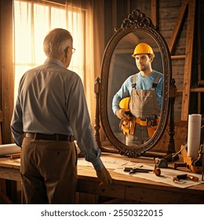
2030 Vision | Platform and Company Vision Speeches
What Will Resonate with your Team? Clients? Add-Ons?
Identity & Strengths
What makes your firm unique and successful?
What part of your firm’s DNA do you want to protect?
Future & Impact
What excites you most about your firm’s future?
What impact do you want your firm to have by 2030?
What do you want your firm to be known for?
How and where do you see the most growth?
Purpose & Passion
Why are you passionate about leading the firm?
Why did your firm choose Trilon?
If your firm or team were a person, animal, object, or natural phenomenon — what would it be, and why?
Empathy & Leadership
If you were an ambitious younger employee, what would you want to hear from leadership?

Slide 29
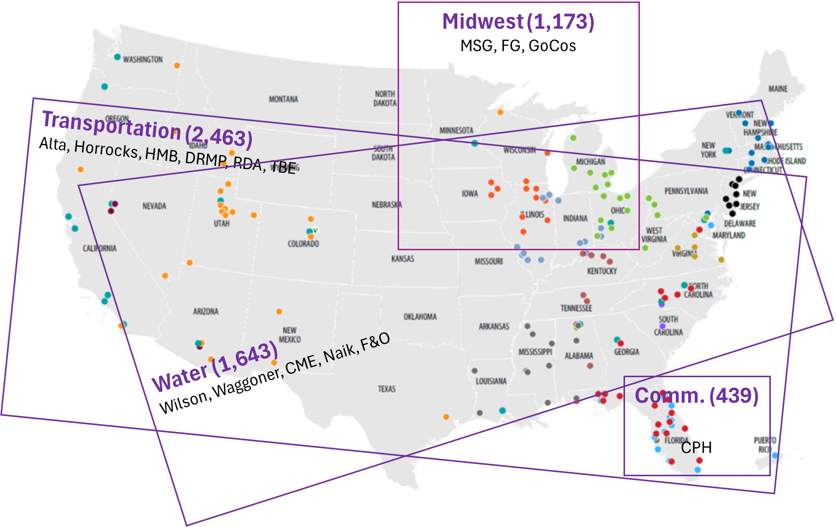
Platform Structure | 2025
Current Platform Structure did a great job standing Trilon’s model up but there is opportunity for improvement
3 End Markets & 1 Regional Platform
Unbalanced Platforms (2,463 vs. 439 staff)
Limited Runway for Transport. (6 firms)
Inefficiencies in Travel (& Active Leadership) for Transport. & Water
Mostly Regional Synergies (Florida, SE, SW); some National (Alta, WizPak)
Sources: HC Dashboard 07/14/2025

Slide 30
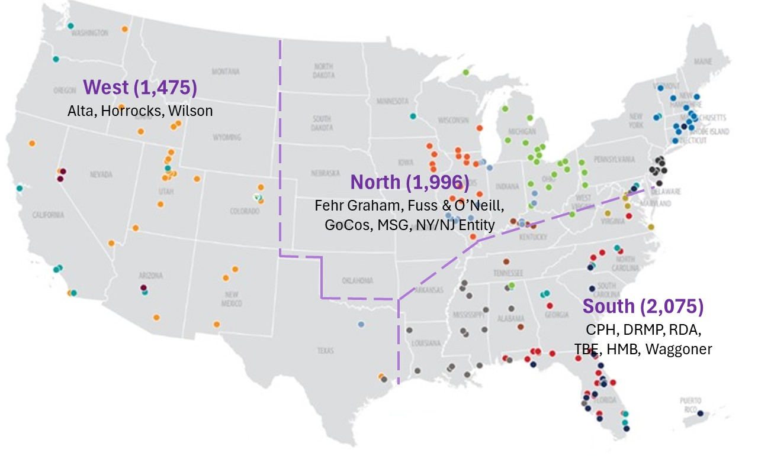
Connective Tissue | 2026 and Beyond
What’s Next – (a) finishing year strong, (b) working on connective tissue under new structure
Connective Tissue: we’ll ask for your help thinking through how we can improve connection across Regions, End Markets and Technical Practices in the new Platform Structure
Sources: HC Dashboard 07/14/2025

Slide 31
Marketing
Thank You
Company Visions
Scaling Marketing
Trilon U
Seriously, Thank You

Slide 32
Questions? Comments?
2025
2030
2035

