Slide 1
Decide. Plan. Win.
Leveraging Go/No-Go and Capture Planning to drive better outcomes
Kathy Nanowski, MBA, CPSM
Vice President | Director of Marketing and Communications
Kathy.Nanowski@fando.com

Slide 2
Agenda
Why Change?
Sales Funnel Stages
Opportunity Plan

Slide 3
Award Misconceptions
“We do good work”
“People have to like you”
“Work must be spread around”
“The best proposal/presentation wins the job”
You have to do the work to win the work

Slide 4

All Things Are Not Equal
Success ratios
answering an RFP
Only if no one has worked with the client before
1
Number of bidders

Slide 5
Types of Business Strategies
A company may create value based on price, technological leadership, customer service, or some combination of these and other factors.
Cost Leadership Strategy - strive to be the lowest-cost producer using operational excellence
Differentiation Strategy - development of services with unique characteristics valued by customers. Culture of innovation that is very protective of its entrepreneurial environment
Specialization Strategy - develop a competitive advantage based on customer service and strive to deliver unique and customizable services to meet their customers’ needs and increase customer loyalty

Slide 6

Types of Business Strategies
• Specialization Strategy - develop a competitive advantage based on customer service and strive to deliver unique and customizable services to meet their customers’ needs
The Most Effective Method to Deliver this Strategy is Through Consistent Client Communication

Slide 7
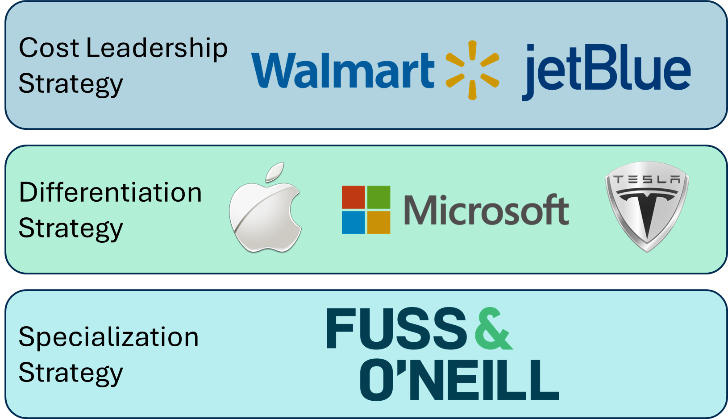
Differentiation

Slide 8


Be Amazon
•The only way to separate our firm from our competition is to show the client you completely understand their needs and wants.
•Clients tend to award work to individuals they trust, and they trust who they know

Slide 9
Key Outcomes
Use a mini Go/No-Go to decide if an opportunity is worth creating an Opportunity Plan.
Build and implement an Opportunity Plan with clear action items and strategies.
When the RFP is released, conduct a full Go/No-Go to confirm pursuit.
Our goal is to engage all employees in business development so that we can share a common language using a proven sales process.

Slide 10
Opportunity Plan
Capture Plan

Slide 11
Quick Go/No-Go Checklist
Is there really a project?
  Yes = proceed Maybe / Not sure yet = No
Do we have access to client decision-makers or influencers?
Do we have enough time to position and prepare?
Can we realistically deliver if we win?
  (Consider capacity, expertise, and resources.)
We can only work on one thing at a time. Before you decide to pursue a lead, ask yourself these four basic questions

Slide 12



Opportunity Plan Workshop
Purpose:
Develop a strategy (Action Plan) to Improve Your Position of Winning
Process:
Identify Decision Makers, Roles and Unique Needs
Acknowledge Red Flags
Identify Strengths
Create actions to leverage strengths and to eliminate problems/issues

Slide 13
Opportunity Plan Workshop
Background – Opportunity Owner (5 minutes)
People involved, Teaming, Competition (15 minutes)
Red Flags (5 minutes)
  Problems, issues, challenges, lack of information, price, budget issues
Strengths (5 minutes)
  Coaches, judges in your pocket, competitive weakness, recognized solutions
What do you want to know? (5 minutes)
  Fairy godmother
Possible Actions (10 minutes)
  What will you do to remove the Red Flags and use your Strengths?
Best Actions (5 minutes)
  What action, who does it, with whom & when?

Slide 14

Pursuing The Right Deals
To increase your probabilities of success, you will want to pursue:
Clients who want to do business with you rather than clients you want to do business with.
Projects where you excel and clients recognize your expertise, rather than projects you’d like to have.
If you are proactive, you will find many such opportunities and your closing percentages (hit rates) will be greater.

Slide 15

Ideal Client Criteria
Values our expertise
  Treats our services as strategic not as a commodity; open to negotiating change orders and amendments.
Professional and principled
  Creative, intelligent, respectful, and operate with integrity.
Committed partners
  Stable, loyal, and invested in long-term consultant relationships.
Financially reliable
  Pays on time per contract terms and consistently funds large-scale projects.
Well-connected
  We have strong decision-maker relationships or can leverage our “golden network” to build them.

Slide 16

Ideal Opportunity Criteria
Strong Revenue Potential
  Opportunity for significant profit and/or follow-on work.
Clear Differentiators
  Highlights our firm’s unique strengths and value.
Aligned Expertise
  Falls within our technical wheelhouse and capabilities.
High-Impact & Visibility
  Supports DEI goals and positively impacts communities we serve.
Clear Project/Site Understanding
  Demonstrates understanding and experience with project-specific issues.

Slide 17
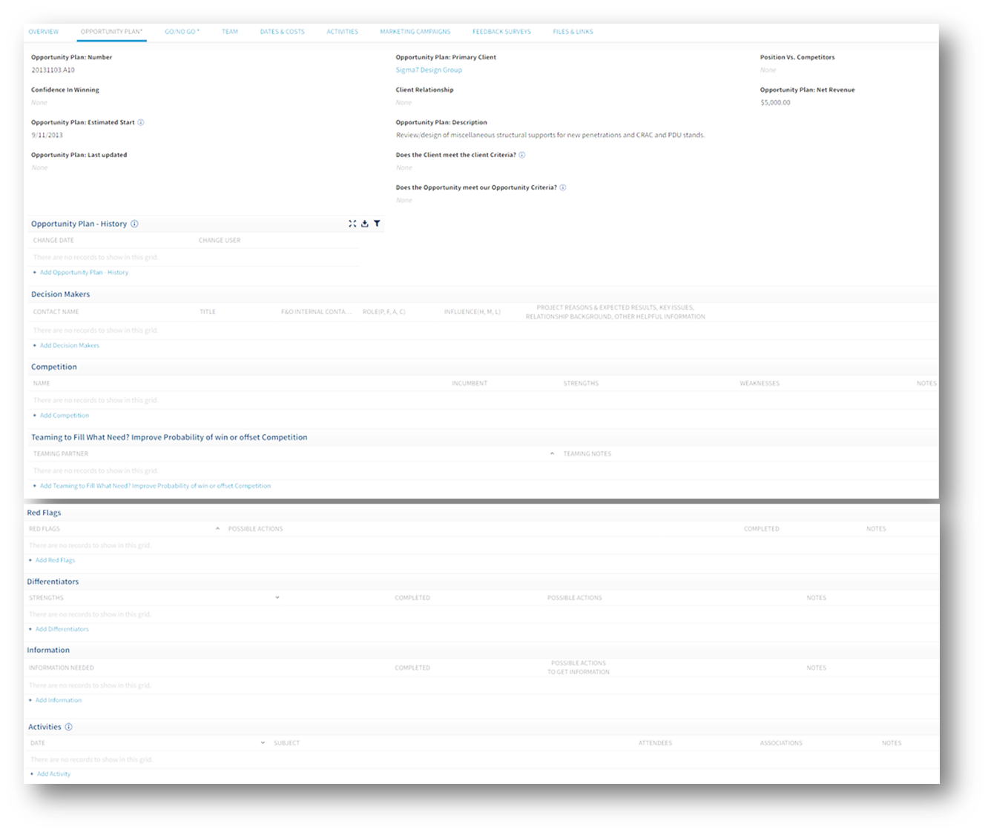
Ideal Opportunity Criteria
Opportunity Plan
Deltek
Potential for significant revenue and profit and/or significant follow-on work
Clear differentiators for
Fuss & O’Neill
Projects in our technical wheelhouse
High profile with good exposure, community recognition
We have specific understanding and experience with project/site issues

Slide 18
Opportunity Plan
Excel

Slide 19
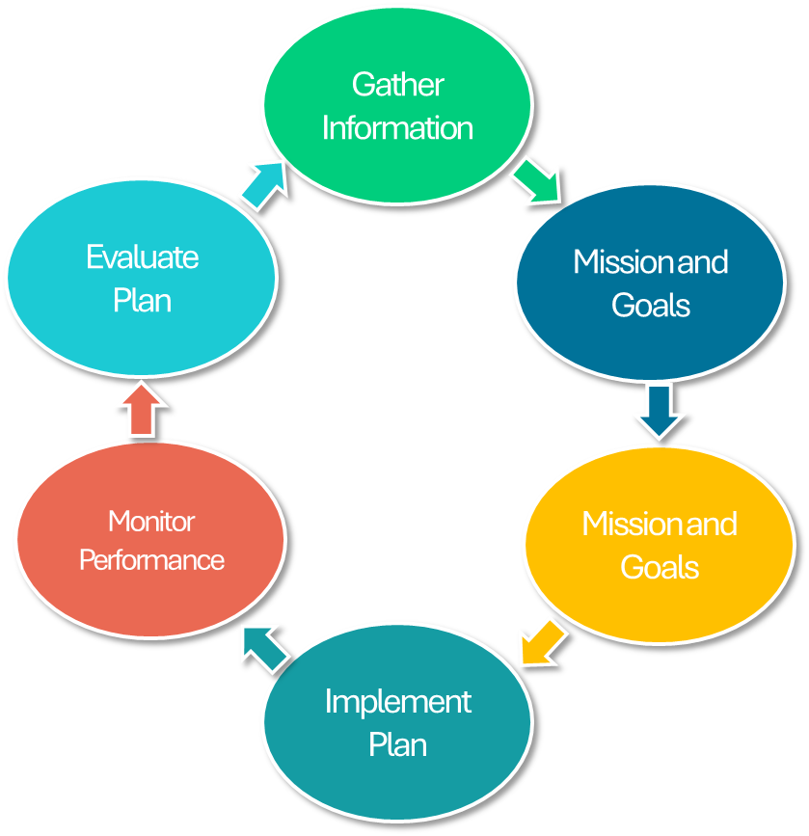
Opportunity Plan Thresholds
When should I do an Opportunity Plan?
It’s a significant opportunity
Big dollar sale
Strong competition
Lots of confusion or uncertainty
Well before an RFP hits the street

Slide 20


Define & Evaluate the Project

Slide 21
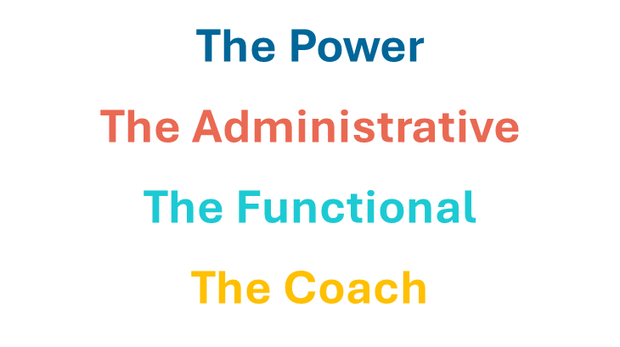
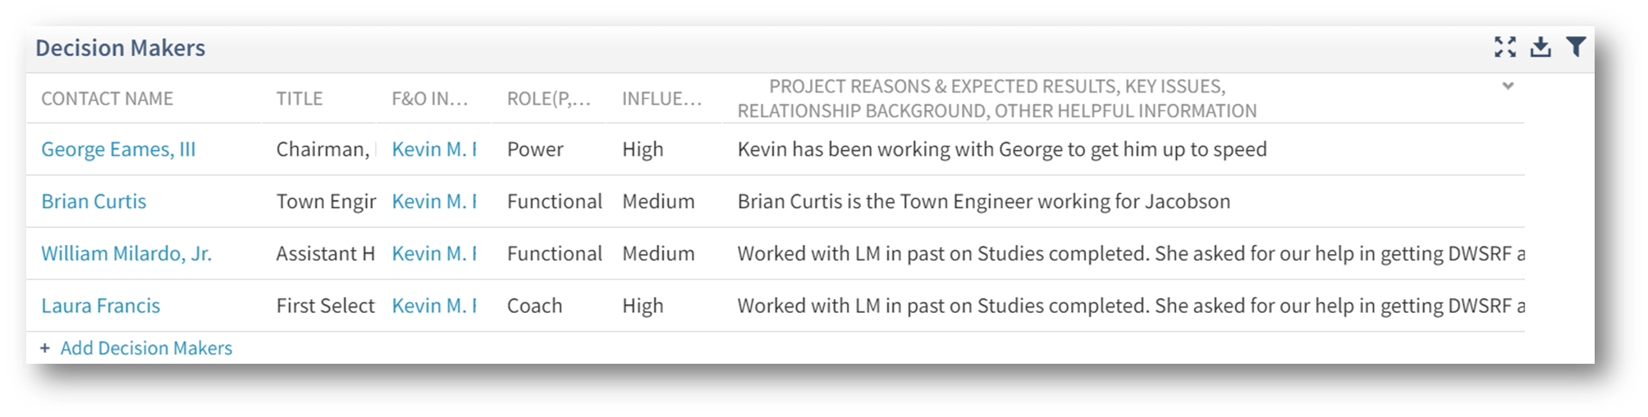
Roles of the Decision Makers Involved
All can play multiple roles
All have their own opinions
All are involved in the decision-making process

Slide 22


Roles of Decision Makers
The Power
Role: The Primary Decision Maker – Only 1
Gives final approval to award
Controls expenditure and release of funds
Has discretionary use of resources
Has veto power
Can say Yes (and make it happen)
Focus: Bottom line and impact on organization​
Asks: ”Is this the right firm to deliver meaningful impact and value?

Slide 23

Roles of Decision Makers
The Administrative
Role: Screens out. Often there may be many.
They establish the specs of what it’s to be
and the regulations
Judge measurable, quantifiable aspects of your proposal
Gatekeepers
Cannot give final approval
Can veto based on specs
Focus: Match specifications in their areas of expertise
Asks: ”Does this meet the specified criteria?”

Slide 24

Roles of Decision Makers
The Functional
Role: Judges impact on job performance. There often are many.
They use the services or may oversee those that do
Personal because they will live with your solution – important group not to ignore
Direct link between their success and the success of your product, services or solution
Focus: The job to be done
Asks: ” How does this impact my job responsibilities?”

Slide 25

Roles of Decision Makers
The Coach
Role: Acts as a guide for this sale
Wants ONLY your solution
You have credibility with this individual
S/He has credibility with other decision-makers
Focus: Your success with this proposal
Asks: ” How can we make this happen?”
Coaches can be internal or external to a client organization.
They can be teaming partners or fellow employees.
Share your Opportunity Plan with your coach!

Slide 26


Degree of Influence & Internal Contact(s)
Degree of Influence
Varies for each project/sale (H,M,L)
If Unknown…
Internal Contact(s)
Team sport
Rely on your internal coworkers

Slide 27
Factors Impacting Key Players
Project Reason – Why do they want this project?
  Boss said to do it!
  Self-promotion or survival - It’s my job!
Expected Results– What outcomes do they want and how do they want it done?
  What is considered success
  On budget or by set date
Key Issues – What problem are they trying to solve?
  Measurable, tangible, quantifiable, benefits and features that this person wants
  Performance – Easy to operate, easy to manage, low maintenance
  Technical Scope – Completed in 300 days, $50,000 budget, 4 Pumps
If Unknown…

Slide 28
Other Information
Relationship Background – How well do we know them?
  How Many Years
  Strong Relationship or Just Beginning
  Can You Ask Them Anything?
Other Helpful Information
  Relationship with Selection Board
  Experience with Other Companies
  Which Consultants Do They Typically Work With?
If Unknown…

Slide 29
Results Reference Sheets
The Power Role: final approval, releases $ Focus: bottom line and impact on organization | The Functional Role: judge product impact on the job Focus: the job to be done
Higher return on investment Reduced costs Increased efficiency/productivity Low cost of ownership Flexibility Profitability Smooth cash flow | Reliability Increased efficiency Upgrade skills Fulfill performance requirements Best problem solution Do their job better/faster/easier Excellent service Easy to learn and use
The Administrative Role: judge match to specifications, screen out Focus: match to specifications | Coaches Role: give data, guild to other decision makers Focus: your success with this proposal
Meet specifications Exceed specifications Timely delivery Best technical solution Discounts/low bid/price Terms and conditions Meet legal requirements | Note: Coaches don’t have their own Results, only Wins. Coaches only have Results if they are playing another role.

Slide 30
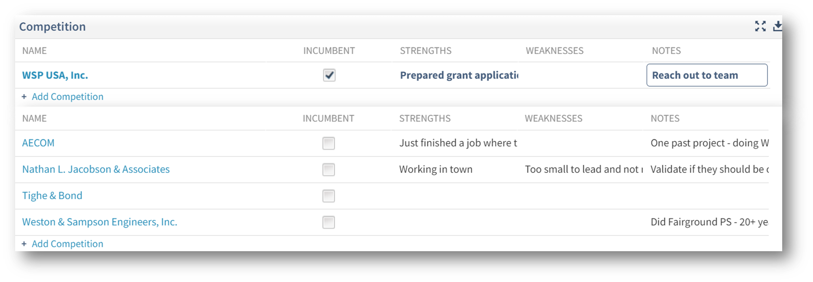
Teaming
Build Your Team Early
  Enough time to ask Client who they like working with
  Introduce teaming partners to the client
  Who is competition using, counteract advantages
  Select Team that could improve probability of winning

Slide 31
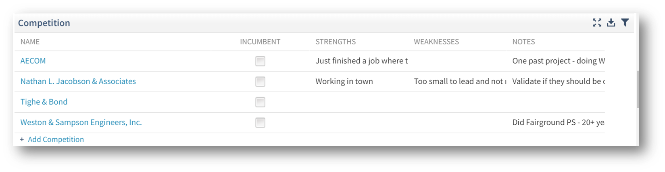
Competition
Different types of competition:
  Give it to a competitor
  Do nothing
  Do it themselves
  Use the money for something else
What does the client like, what do they dislike?
What actions can you take to weaken their position?
  #1 Differentiator – know the client's needs and wants better than your competitor does

Slide 32

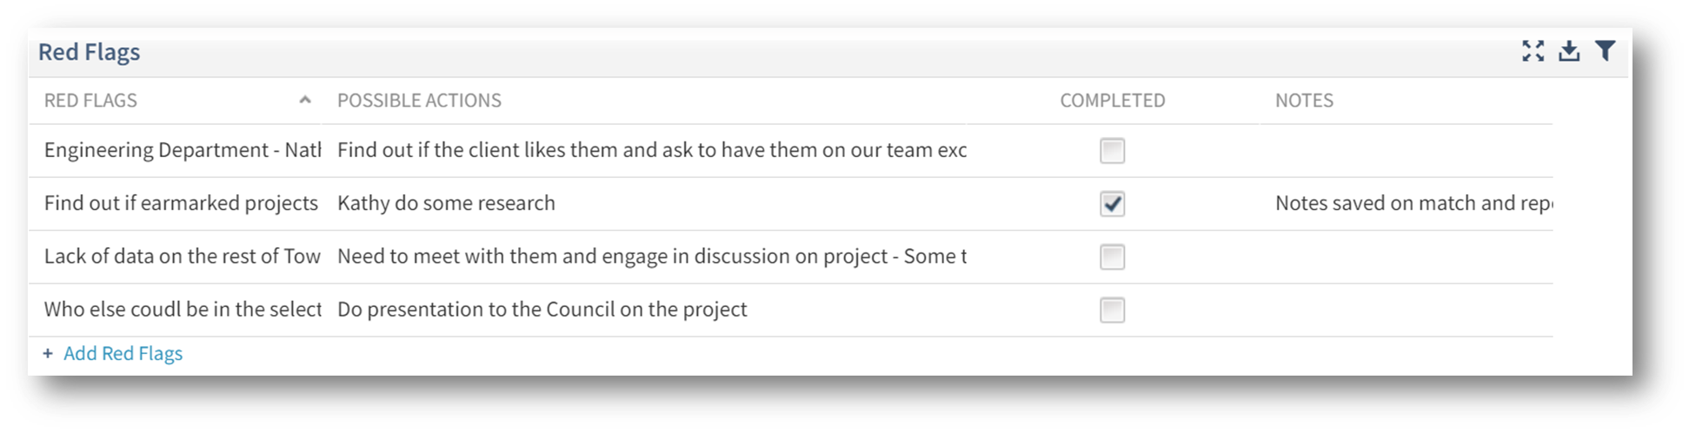
Red Flags
Critical Information that is missing or unclear
New or uncontacted people involved
Uncertainty about any information
This should create a possible action

Slide 33

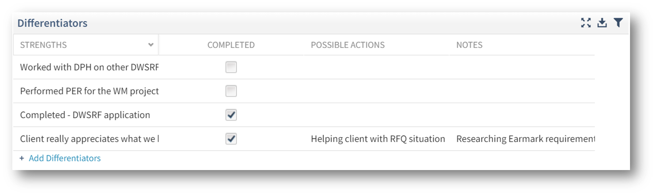
Strengths
Areas of differentiation
Must be relevant to the current opportunity
Lessen price sensitivity
Unique to the competition
Opportunities used to improve position

Slide 34

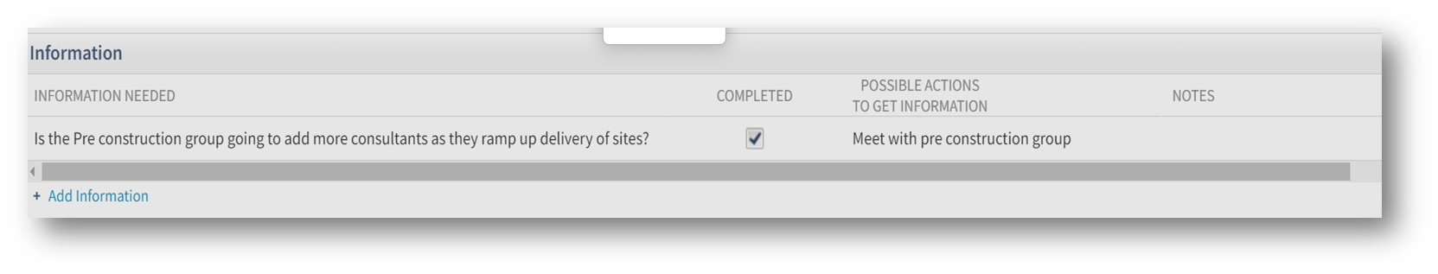
Information Needed
What do you want to know?
If you had a fairy godmother and she could provide you with all the answers, what would those questions be?
Who do you like (not like) to work with?
Who else will be part of the decision?
Will there be an interview, is it the same decision makers?
What is your budget?
When is your estimated start date?
What should we avoid in our approach?
Is there a DBE or MBE/WBE requirement?
How would this project exceed your expectations?
If you have an approach in mind, now's the time to share it!

Slide 35
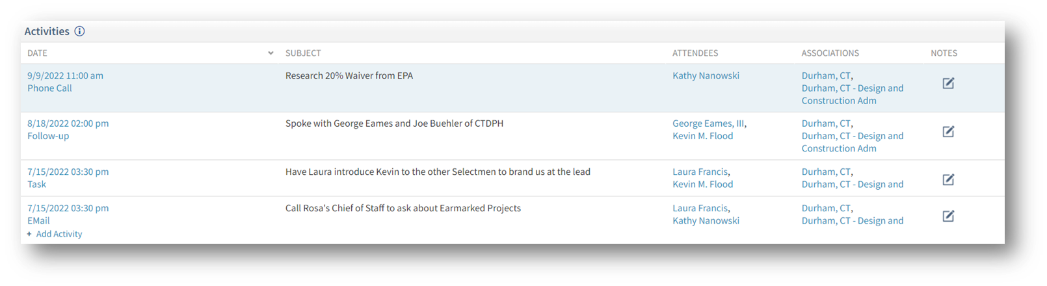
Best Actions = Activities
Most Important Part of the Opportunity Plan
Who is doing what, by when, to find out what?
Acknowledge Issues and Questions (Red Flags)
Identify Strengths
Create actions to leverage strengths and to eliminate problems/issues
Activities created when using Vantagepoint
Sends reminders
Opportunity Owner knows when it was completed
Other activities can be added anytime

Slide 36
Opportunity Plan Guide
Examples of Red Flags
Lack of information
New players
Negative client profile
Negative opportunity profile
Poor history with client
Competition relationship with client
Poor product/service/support fit
Unknown needs and wants
Project start date to soon
More than one Power Influencer
An unclear opportunity
Believing there is a power influencer for an account versus for this particular opportunity
No differentiators
Low bid project
Examples of Strengths
Solid past history with the client
First consultant to identify the needs of this client, so you influenced the RFP
Understand needs and wants of the Power influencer
Product strengths, fit to need
Have a coach
Ideas for Other Possible Actions
Is there an action for every Strength and every Red Flag?
When should the Opportunity Plan be reviewed again?
Should the Opportunity Plan be reviewed with your coach for additional coaching?

Slide 37
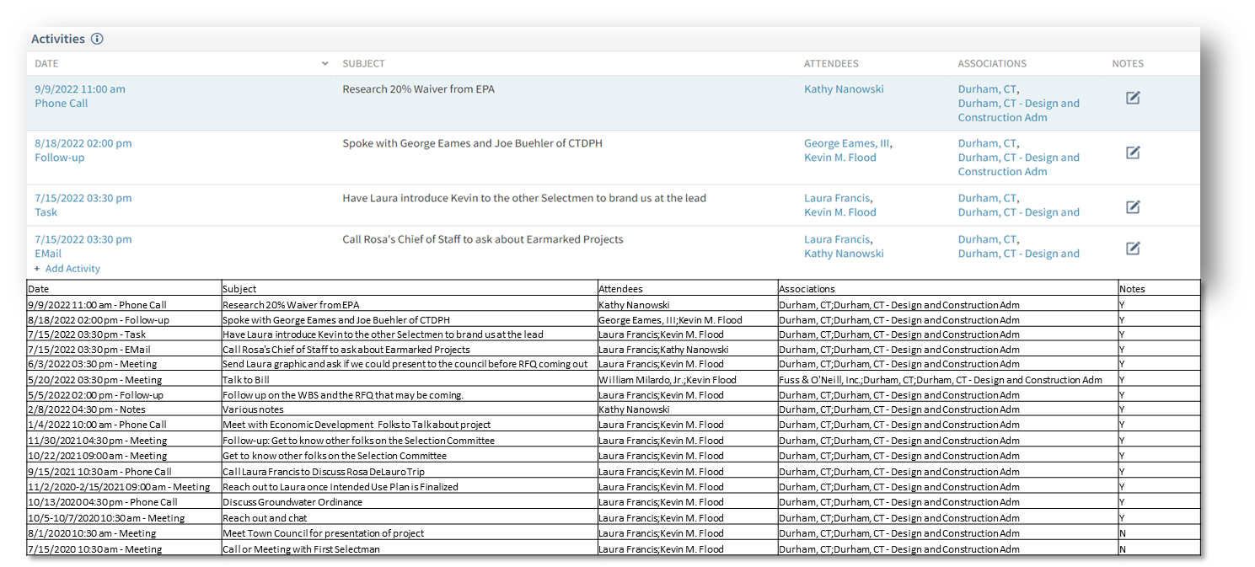
Why Use Vantagepoint For Action Items
To share business development info: (e.g. a meeting or client conversation with others at the Firm)
To set reminders for future tasks to yourself or others
To better coordinate when and what you share with a client (a party invite, tradeshow invitation, article, etc.)

Slide 38
Post Opportunity Plan Go/No-Go Review
Now that the RFP is out, it's time to reassess: Is this worth our investment?
Competitive Pursuits​ | Sole Sourced Pursuits​
Will our staff be excited about the project?​ | Will our staff be excited about the project?​
Do we know the client’s organization?​ | Project required to maintain/improve relationship​
Have we met with the project manager about this Project? | Client confirmed sole source to us?​
Did we talk to the client before the RFP hit the street? | Is Project funded?​
Does the Client meet our Client Criteria​? | Will provide conduit for future/follow-on work​
Does the Opportunity meets our Opportunity Criteria​? | ​
Do we have adequate time to prepare a quality response?​ | ​Reason for Go or No/Go
Any issues that could delay schedule/funding?​ | Promotional Hour Approved
Is the project funded?​ | ​Promotional Dollars Approved
Non-price advantage over “low-ball” competitors?​ | ​
Operating profit % of net revenue?​ | ​
If <$25K, will it lead to future work?​ | ​

Slide 39
Conclusion
1
2
3
4
5
Conduct a quick go/no-go to determine if the opportunity justifies planning and indirect effort.
Opportunity Plans should be developed for key projects.
Opportunity Plans are living documents.
When you’re done with your first meeting, schedule your next one!
Opportunity Plans along with a solid Go/NoGo will help prioritize and position our firms for future work.

Slide 40
Questions
Kathy Nanowski, MBA, CPSM
Vice President | Director of Marketing and Communications
Kathy.Nanowski@fando.com

